Slide 1


Slide 2
New international standards for gender statistics in paid and unpaid work
Part I: International standards setting
Part II: Concepts and definitions
    Framework for forms of work
    Labour Force and measures of labour underutilization
Part III: Conclusion and ways forward
Gender mainstreaming in
work and labour statistics
Tinonin, Cecilia ILO

Slide 3
International standards
International standards relate to concepts, definitions, classification and other methodological procedures agreed to representing best practices
International standards aim at:
  Increase the likelihood of having international comparable statistics
  Comparability across time within a country
In the area of measuring unpaid care and domestic work, there is a great need for enhancing international comparability through the provision of common concepts, definitions and methods
  Time Use and the SDG 5.4.1
Tinonin, Cecilia ILO

Slide 4
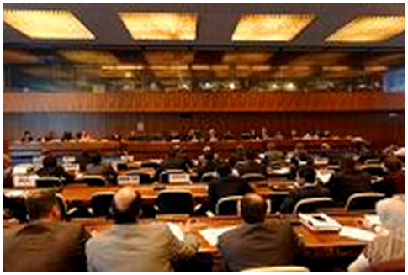
International Conference of Labour Statisticians (ICLS)
ICLS is the world’s recognized standard setting body in the area of labour statistics
Since 1923, it is convened roughly every five years by ILO
It is composed of experts from Government, employers’ and workers’ organizations
It is invited to make recommendations in the forms of resolutions and guidelines. Tradition is that decisions at ICLS are taken by consensus
Tinonin, Cecilia ILO

Slide 5
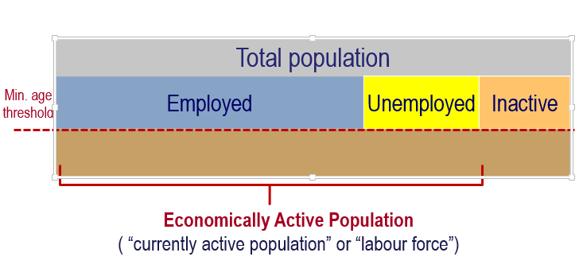
Employment & Unemployment in previous standards (13th ICLS, 1982)
Tinonin, Cecilia ILO
Notes:
Employment concept too wide
Covers diverse kinds of work activities in a single category
Not all productive activities captured
Unpaid household services not recognized
Unemployment concept too narrow
Not sufficient to capture range of responses to labour market downturns in different contexts
Not as useful to inform labour & social policy
Does not capture differences in economic structures & work patterns across countries / groups / regions
Does not fully support monitoring labour market behaviour

Slide 6
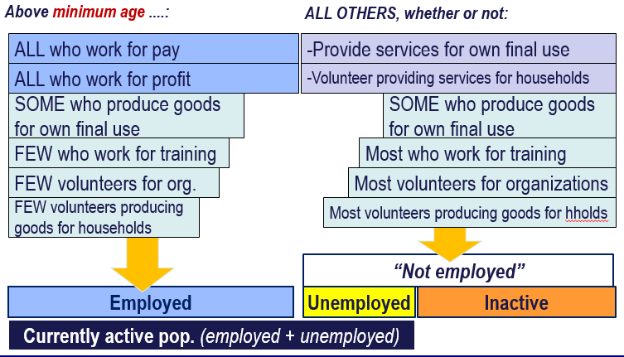
Employment & Unemployment in national practices…
Tinonin, Cecilia ILO

Slide 7
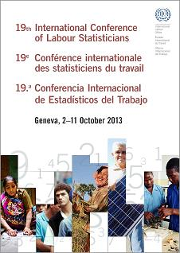
First international statistical definition of Work
  “Any activity performed
  by persons of any sex and age
  to produce goods or provide services
  for use by others or for own use”
  Para 6, Resol I. (19th ICLS, 2013)
Tinonin, Cecilia ILO

Slide 8
Work and the System of National Accounts
Activities
Productive activities
Market units
Incorporated, unincorporated
Goods
Non-market units
Government, Non-profit institutions
Services
Households
producing for own final use
Goods
Non-productive
activities
Services
Goods
Sleeping
Learning
Own-recreation
Begging
Stealing
Services
Included
Previous activity scope for “employment”
New concept of “Work” == productive activities
General production boundary
SNA production boundary
Tinonin, Cecilia ILO

Slide 9
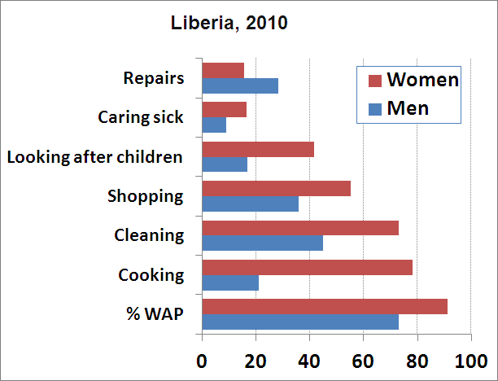
Illustration:
Own use providers of services by sex and activity cluster (%WAP)
Most unpaid household services predominantly performed by women,
except for household repairs
Source: ILO calculations based on national data (LFS-CWIQ, 2010)
Tinonin, Cecilia ILO

Slide 10
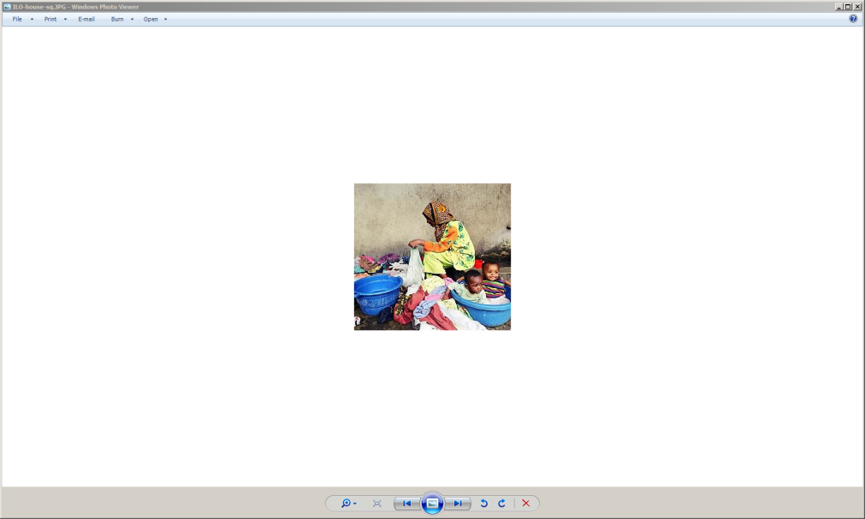
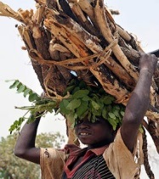
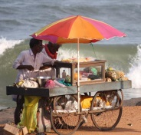
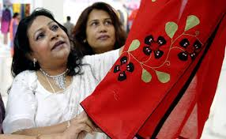
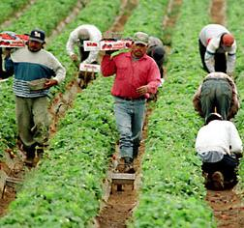
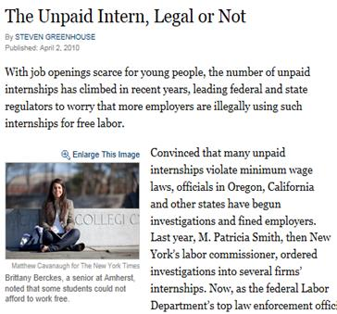
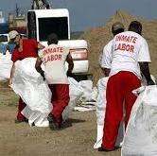

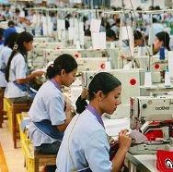
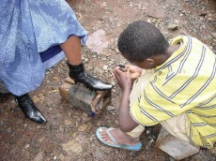
Forms of Work Framework:
By main intended destination & transaction type
Work
(i.e. ALL activities to produce goods and services)
For own final use
(by households)
For use by others (i.e. other units)
For remuneration (i.e. for pay or profit)
Without remuneration
Employment
(work for pay or profit)
Reference concept for Labour Force statistics
Own-use production work
Unpaid trainee work
Other work activities (e.g. unpaid compulsory work)
Volunteer work
Services
Goods
Services
Goods
S
G
S
G
G
S
SNA labour input
Tinonin, Cecilia ILO
Notes:
A classification of productive activities (not people!)
Distinguishes different “types” of work (i.e. productive activities)
Main intended destination of production (own final use / use by others)
Type of transaction (for remuneration / without remuneration)
Enables their separate measurement in full
Supports more targeted monitoring to inform policymaking
Permits coherence with national accounts
National production & satellite accounts

Slide 11
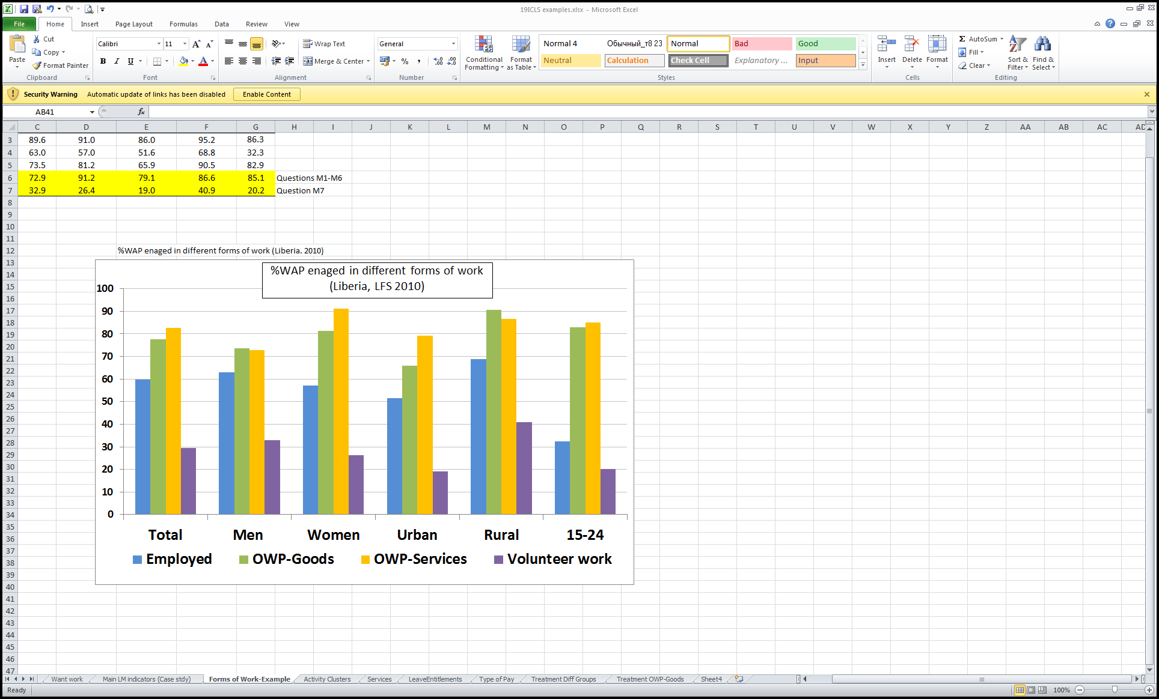
Illustration: Measurement of participation in
different forms of work becomes possible
Source: ILO calculations based on national data (LFS-CWIQ, 2010)
Tinonin, Cecilia ILO

Slide 12
By Labour Force
ALL OTHERS > age, whether or not:
-Provide services for own final use
Above minimum age ...:
-Volunteer providing services for households
-Work unpaid for training
ALL who work for pay
-Produce goods for own final use
ALL who work for profit
-Employers
-Own account workers in market units
-Contributing family workers
-Members of market producer cooperatives
-Volunteer through / for organizations
-Volunteer producing goods for households
Without employment (for pay/profit)
Seeking and available for work for pay/profit
Persons in employment
(work for pay / profit)
Yes
No
Unemployed
Outside the labour force
Labour force
Underutilized labour
(with unmet need for employment (for pay/profit)
Tinonin, Cecilia ILO

Slide 13
Labour force & labour underutilization
Improved labour market monitoring across contexts
Working age population
Labour force
Employed
(for pay/profit)
Outside the labour force
Unemployed
Time-related underemployed
Potential
Labour Force
-seeking, not available
-available, not seeking
Want employment
but not seeking,
not available
Do not want employment
Labour underutilization
(unmet need for employment)
Tinonin, Cecilia ILO

Slide 14
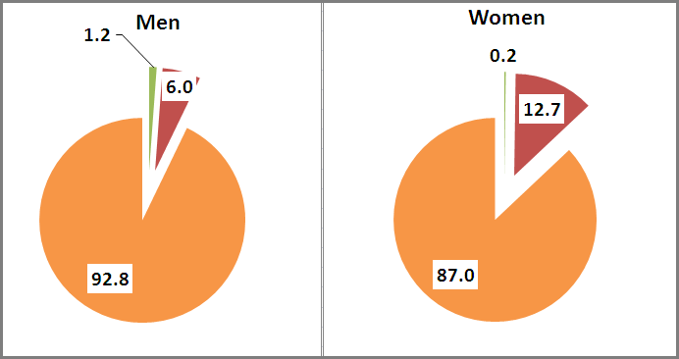

Illustration: Willing non-job seekers
Percentage of willing non-job seekers among persons
outside the labour force (%)
Source: Enquête nationale sur l’Emploi, Morocco 2012
Tinonin, Cecilia ILO

Slide 15
Main reason for not being in labour market
Personal reasons
  Own illness, disability
  Studies, training
Family related reasons
  Pregnancy, family or household responsibilities
  Refusal by family
Labour market reasons
  Past failure in finding a job, gave up looking for jobs
  Lack of experience, qualifications or jobs matching skills
  Lack of jobs in the area
  Considered too young or too old by prospective employers
Lack of infrastructure
  No roads, transport, employment services in the area
Other sources of income
  Pensions, rents
Social barriers
Discouragement
Tinonin, Cecilia ILO

Slide 16
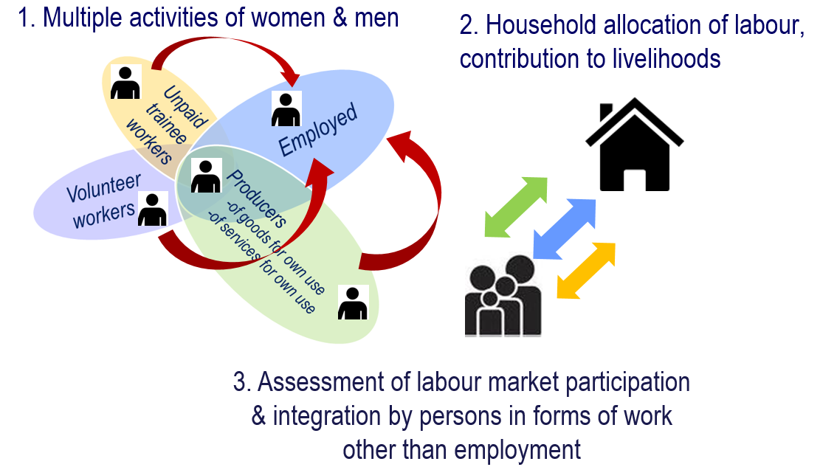
Conclusion on the 19th ICLS Resolution I
Tinonin, Cecilia ILO
Notes:
Replaces previous international statistical standards on
Economically active population, employment, unemployment, underemployment (13th ICLS, 1982)
To become the reference framework
For work and labour market statistics in decades to come
Address gender bias in recognition of ALL work (paid and unpaid)
Make visible participation patterns & quantify contributions
Inform policies targeting different forms of work, paid & unpaid
Working conditions, remuneration, social protection, work life balance, social inclusion & cohesion
Contribute to post 2015 development agenda
Inclusive, sustainable development policies, job growth

Slide 17
ILO LFS methodological programme
Objectives & approach
  To develop evidence-based guidance
  Based on existing national practice
  Aligned with new standards
  Modular approach to support flexible implementation
Expected outputs
LFS toolkit
  Module design (PAPI & CAPI)
  Explanatory notes
  Survey design requirements
  National adaptation guidance
  Indicator computation guidance
LFS
Volunteer work
Own-use provision of services
Own-use production of goods
…
Tinonin, Cecilia ILO

Slide 18
Ways forward
Topic coverage
Overall methodology
Phase 1: 2015-2017
Employment
Labour underutilization
Own-use production work (stylized retrospective questions)
Phase 2: 2018-
  Volunteer Work
  Own-use provision of services
  Labour Force in multipurpose household surveys
Pilot studies
Qualitative phase
  Cognitive interviewing
Operational phase
  Small scale field tests
Statistical phase
  Split sample experimental designs
Implementation partners
NSOs
Partner agencies (UN Volunteers, World Bank, FAO)
Development partners (Data 2X)
Tinonin, Cecilia ILO

Slide 19
Resources and Contact
19th International Conference of Labour Statisticians
  http://www.ilo.org/19thicls
20th International Conference of Labour Statisticians
  https://www.ilo.org/global/statistics-and-databases/meetings-and-events/international-conference-of-labour-statisticians/20/lang--en/index.htm
ICLS Resolutions and Guidelines
  http://www.ilo.org/global/statistics-and databases/standards-and-guidelines/
ILO LFS pilot studies programme
  http://www.ilo.org/stat/Areasofwork/Standards/lfs/lang--en/index.htm
STATISTICS contact
  statistics@ilo.org
Tinonin, Cecilia ILO

Slide 20
Thank you!
Tinonin, Cecilia ILO

