Slide 2
Measuring Unpaid Care Work to Inform Policy-Makers on Women’s Economic Empowerment:
Lessons learnt from the OECD Policy Dialogue
Gaëlle Ferrant

Slide 3
OECD Policy Dialogue on Women’s Economonic Empowerment and Unpaid Care Work: a special focus on SDG 5.4
Unlocking Women’s Economic Potential by Recognising, Reducing and Redistributing Unpaid Care and Domestic Work through better policies addressing:
Infrastructure
Social protection
Public services
Shared responsibilities within the household and gender norms
Generate cross-country comparable data
Produce evidence-based analysis
Provide policy guidance on “what works” to Recognise, Reduce and Redistribute unpaid care and domestic work

Slide 4
Generating cross-country comparable measure of unpaid care work
Time Use Surveys (TUS) have been conducted in 83 countries (30 OECD countries + 53 non-OECD economies)
A number of comparability issues affect TUS, e.g. different classifications, population coverage, simultaneity of activities, etc…
Selection criteria:
Population coverage (e.g., national, urban, rural)
Year of the survey (TUS are conducted every 5/10 years)
Availability of micro data
Coverage of different world regions and income levels (low- and middle-income countries)
Bangladesh, Ethiopia, Peru, South Africa + 30 OECD Countries

Slide 5
Recognising UPCW as a female economic contribution
Unpaid care work is not considered an “economic activity”:
Unpaid goods and services produced by household members for their own consumption were excluded from GDP
ineffective policymaking that does not account for the constraints individuals, particularly women, face when pursuing different economic and social activities
incorrect inferences about an individuals’ well-being and the value of time
Unpaid care work represents a significant share of countries’ GDP:
USD 11 trillion, or 9% of global GDP (ILO, 2018)
In the UK: ‘extended GDP’ (home produced services + GDP) grew at an average annual rate of 3.8% per year between 2005 and 2014, compared to 3.5% using the standard GDP computation
As women perform more than 75% of household productive activities, these calculations provide a more realistic estimate of women’s contribution to the national economy, challenging the traditional view of men’s greater economic productivity

Slide 6
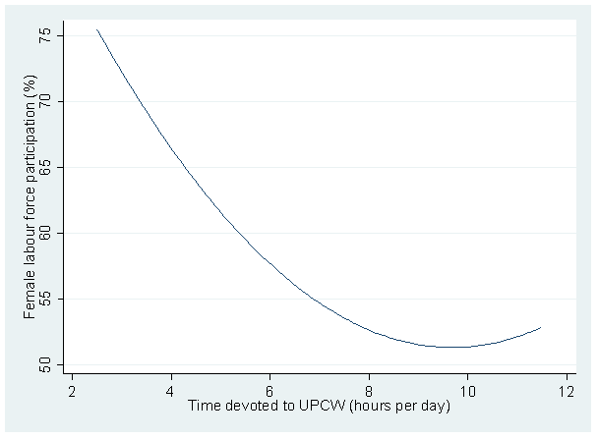
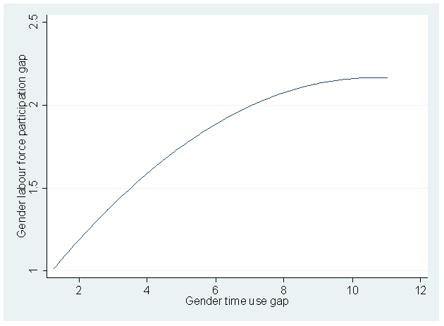
Unpaid Care Work: the Missing Barrier to Women’s Economic Empowerment
Higher inequalities in UPCW, higher inequalities in labour market outcomes
Note: Controlling for GDP per capita, fertility rate, urbanisation rate, maternity leave and gender inequality in unemployment and education.
Source: World Bank (n.d.), World Development Indicators and OECD (2018), Gender, Institutions and Development Database.

Slide 7
GDP per capita
access to time-saving technology and infrastructure
Huge time women spend on UPCW
Gender Gap in UPCW and GDP
GDP per capita
Slight time men spend on UPCW
Discriminatory social norms as measured by the SIGI
Gender Gap in UPCW time but persistent

Slide 8
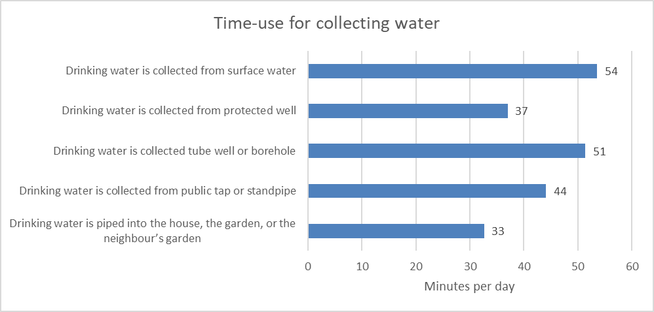
Informing Policy-Makers: focus on access to infrastructure
Access to electricity:
34% of the Ghanaian women do not have access to electricity in their house
Having electricity at one’s house increases women’s time in paid activities (formal or informal) by 73 minutes
Access to water
19% of women are fetching water vs 6% of men
for 25% of the Ghanaian Households drinking water is piped into their house, their garden, or their neighbour’s yard

Slide 9
Conclusion
UPCW: a missed opportunity
policies very rarely incorporate addressing UCW as an objective
(harmonised) TUS are restricted
UPCW: a barrier to women’s economic empowerment
Higher gender time use gap, higher gender gaps in labour market outcomes
Need for public commitment:
GDP growth itself would not be enough to achieve equality on both UPCW and labour market outcomes
Social transformation challenging traditional gender norms is needed to promote women’s economic empowerment

Slide 10
Thank you for your attention
Gaelle.Ferrant@oecd.org
More information on
OECD Policy Dialogue on Women’s Economonic Empowerment and Unpaid Care Work at
http://www.oecd.org/development/womens-economic-empowerment.htm
Social Institutions and Gender Index (SIGI)
www.genderindex.org
OECD Time Use Database
http://www.oecd.org/gender/data/
Gaëlle Ferrant

