Slide 1



Slide 2
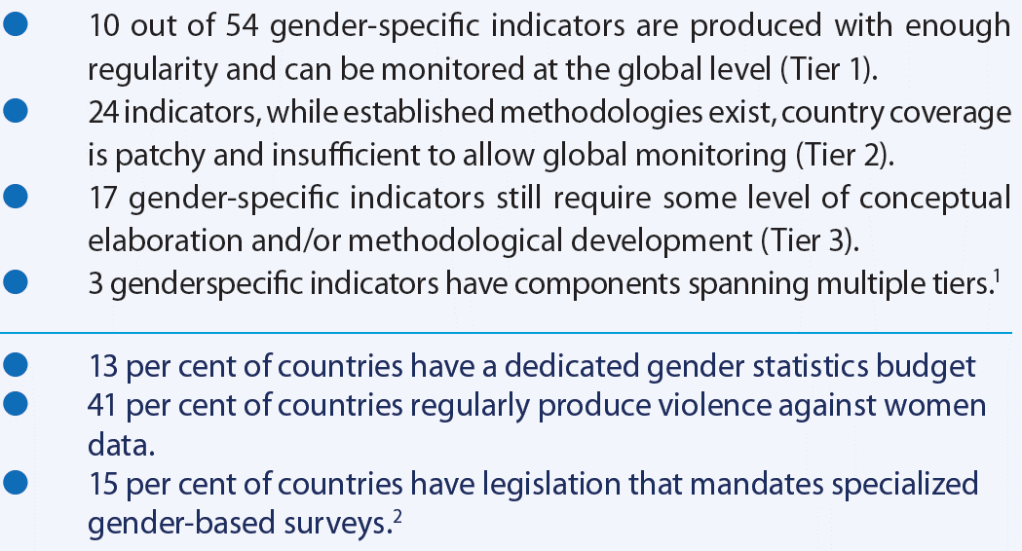


2030 Agenda: opportunity for gender statistics
Challenges to monitor and provide accountability on SDGs gender related aspects
1 Source: UN Women. Turning Promises into Action: gender Equality in the 2030 for Sustainable Development, 2018
2 Source: United Nations. 2013. Report of the UN Secretary General on Gender Statistics.

Slide 3
Timeline in Mexico towards the positioning of gender statistics
1995- 1998
2000- 2002
2006-2007
2016-2020
INEGI+UNIFEM+
INMUJERES+ DAG CEPAL
Creation of the Gender Statistics Working Group of the Statistical Conference of the Americas (SCA-ECLAC).
INEGI+ UN Women+ INMUJERES+ Ministry of Foreign Affairs + Global and Regional partners
-2016: Centre Of Excellence on Gender statistics (CEGS) Announcement by Chancellor at the launch of the FPI “Making every woman an girl count”.
-2017: Agreement UN Women-INEGI for the CEGS´s design.
-2018-2021: Agreement UN Women-INEGI for the CEGS´s Installation and Operation stage.
INEGI+UNIFEM
1995: Beginning of partnership gender statistics in Mexico within the framework of the Beijing Platform for Action
1996-1998: First survey of the ENUT in Mexico.
2010-2015
INEGI+ UN Women+ INMUJERES+ Ministry of Foreign Affairs
-2013: MOU S-S on gender statistics.
-19 countries with time use information.
⁻ 2015-2030: Agenda and SDGs.
INEGI+UNIFEM+INMUJERES
-2000: 1st International Meeting on Gender Statistics in Aguascalientes
-2001: Creation of SISESIM
-2002: First Expert international meeting on time use and unpaid work in Mexico.

Slide 4

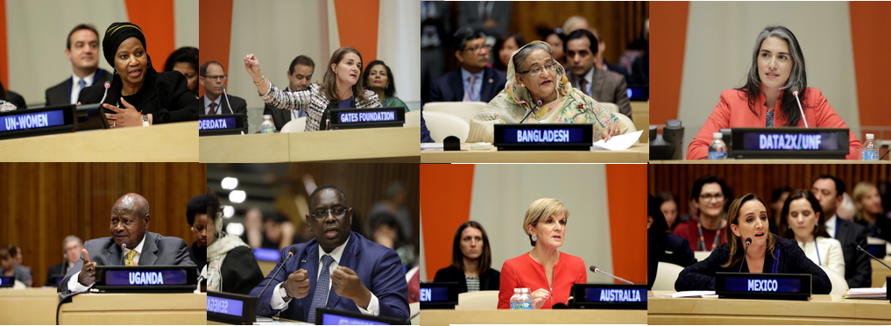
UN Women Global Flagship Program: Making Every Woman and Girl Count
High-level launch event during 71st UNGA (Sept 2016)
The CEGS harness efforts by UN Women in the framework of the Flagship Program Initiative on Gender Statistics “Making Every Woman and Girl Count”.
The CEGS will contribute to make evidence-based and targeted policies to fully implement and track progress on the Sustainable Development Goals (SDGs).

Slide 5


The CEGS is a first-of-its-kind initiative that will:
Articulate the supply and demand for cooperation for the development, strengthening, harmonization, comparability and dissemination of gender statistics.
Lead methodological innovations, knowledge and best practices at the global level to give timely responses face the emerging needs and structural challenges of National Statistical Systems.
Advance knowledge with a cutting-edge agenda.
  Enhance the generation, availability, dissemination, analysis and use of gender statistics.
  Close the implementation gaps.
3. Link stakeholders, initiatives and processes to optimize resources and avoid duplicity and
  Capitalize on the accumulated work and experience.
  Potentiate synergies with on going initiatives, working cooperatively and in a complementary manner (global, regional, national and sub-national).
A pioneering
initiative

Slide 6



Mission:
Support National Statistical Systems (NSS) to improve the generation, analysis and use of gender statistics in selected statistical projects.
Objectives:
1. Strengthen technical capacity of National Statistics Offices (NSO) to produce statistics with a gender perspective.
2. Disseminate knowledge and promote information sharing and best practices on key aspects for gender statistics.
3. Promote analysis, research and innovation on gender statistics in key emerging areas for gender equality.
A COMPELLING CAUSE

Slide 7
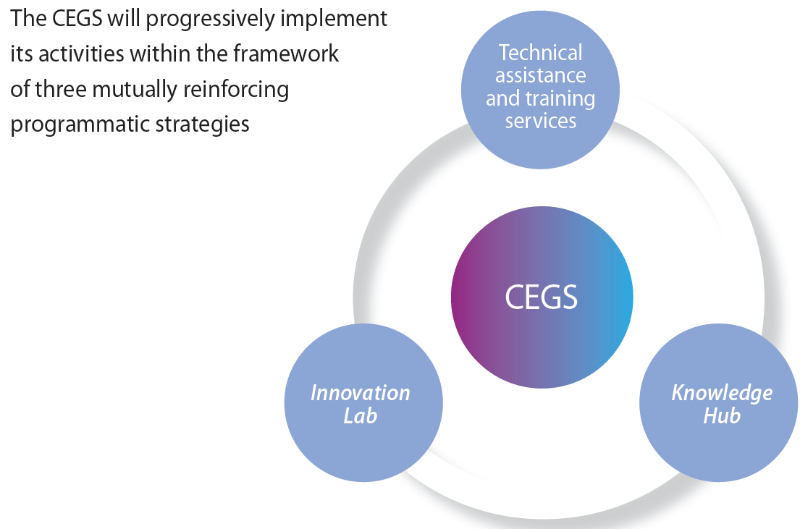
Three programmatic strategies

Slide 8

2018-2020: MAIN PRODUCTS
Inventory of innovations and best practices for the calculation and monitoring SDG indicators
Communication and Fundraising strategies
First topics:
Time use and domestic unpaid work statistics
Methodological tools and demand-driven technical assistance to develop time use surveys and analysis.
Global dialogues on Unpaid Care and Domestic Work measurement, like this First Global Conference.
Geospatial analysis
Innovative methodologies for geospatial analysis on women’s economic empowerment, time use and care work, using census information and other sources. As well as geospatial analysis of femicide/feminicide.

Slide 9

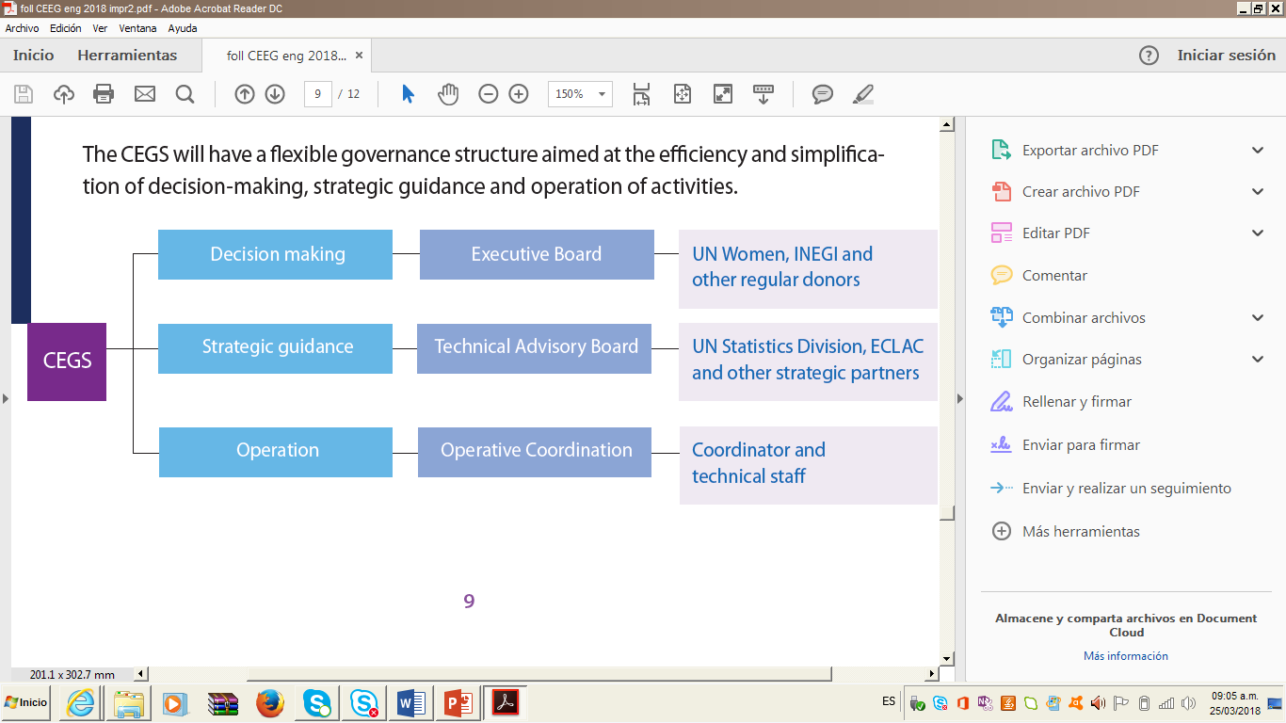
An efficiency-oriented governance
The CEGS will have a flexible governance structure aimed at the efficiency and simplification of decision-making, strategic guidance and operation of activities.

Slide 10
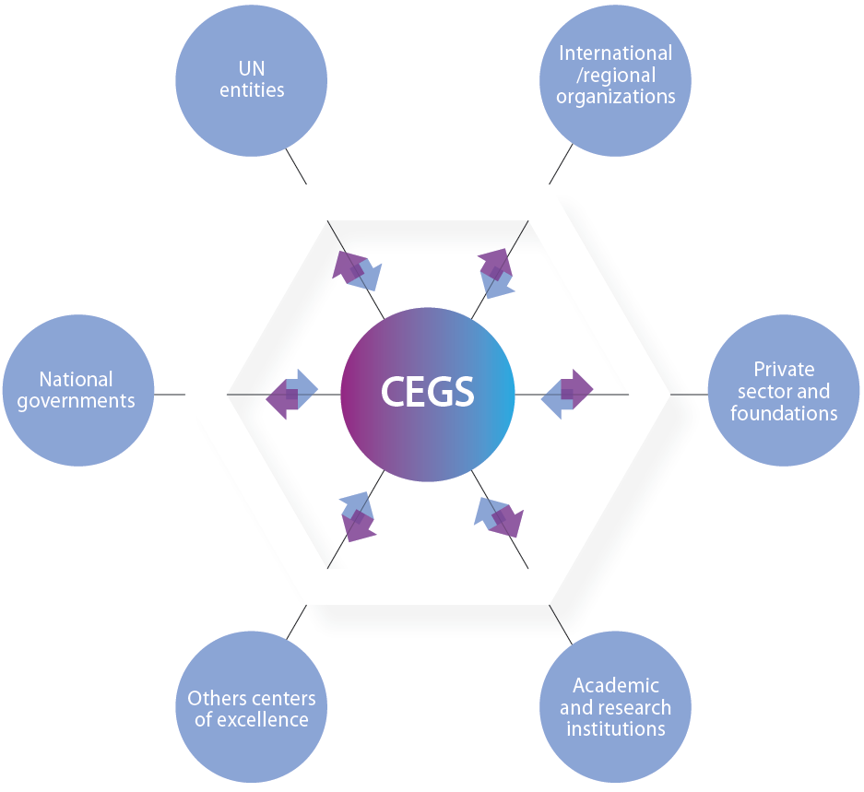
Multiple partnerships
Alliance for international cooperation on gender statistics
Interested countries and strategic partners might join the CEGS:
As donors jointly with Mexico
As partners in specific statistical projects
As part of south-south, triangular and horizontal cooperation schemes

Slide 11
For more information:
CEGS@unwomen.org

Slide 12
Paulina Grobet
Coordinator
paulina.grobet@unwomen.org

