Slide 1
Invisible no more? How time use surveys measure unpaid work
Eleanor Carey, Technical Manager, Data2X
Notes:
Good afternoon. Over the last 2 days we have discussed the vital importance of measuring unpaid care and domestic work to truly value women’s contribution to society, and the technical obstacles we must overcome to make the data more valuable. Now we turn to one of the most challenging topics, how to integrate improved data into the policy process. Without this final step, as we all know, data cannot have the real world impact we all hope for.

Slide 2
Data2X report: Invisible No More?
Country Case Studies
Volume I: A Methodology and Policy Review of How Time Use Surveys Measure Unpaid Work
Written by Mayra Buvinic and Elizabeth M. King
  Featuring an inventory of 257 time use surveys across 88 countries
Volume II: Country Case Studies
  Includes 18 country case studies on the data-to-policy link of
  time use surveys
Albania | Kazakhstan
Cambodia | Mexico
Chile | Moldova
Colombia | Mongolia
Egypt | South Africa
Ethiopia | South Korea
Finland | Thailand
Ghana | Tanzania
India | Uruguay
Read the report and case studies at www.data2x.org/time-use-report
Notes:
In March of this year, Data2X released a report co-authored by our Senior Fellow Mayra Buvinic and Brookings Institution Senior Fellow Elizabeth King focused on how time use surveys measure unpaid work. This paper was both a methodology and a policy review- given the topic of this panel, I will focus on the findings relating to policy linkages. These findings are drawn from 18 original country case studies conducted for the report.

Slide 3
Evidence of policy momentum: unpaid work
Sustainable Development Goals
19th International Conference of Labour Statisticians (ICLS 19)
ICATUS 2016
Indicator 5.4.1
Broadened definition of work
Employment is counted only as work for “pay or profit” →
Harmonizes activities with ICLS 19
Helps ensure international comparability and quality of time use data
Notes:
At the global level, momentum around gathering policy relevant information on unpaid care and domestic work is evident in SDG indicator 5.4.1. Preceding the SDG indicator negotiations however, an agreement among international labor statisticians in 2013 to broaden the definition of what is considered work, puts extra emphasis on measuring all forms of productive activity, both paid and unpaid.
In addition, the updated ICATUS 2016 is responding to increased demand for comparable time use data.

Slide 4
Global Female and Male Labour Force Participation Rate, 1990-2030
Source: ILOSTAT Database
Notes:
The many social, economic, political and ideological factors that led to the current focus on unpaid work are too myriad to discuss in this short time, but a few are worth briefly mentioning. We know that demographic changes over the last decades mean that while the birth rate is dropping globally, populations are living longer, resulting in increased care needs. We know also, that around the world, the unequal burden of unpaid care on women compounded by other barriers to the labour market impacts their engagement in paid work. Women’s global labour force participation rate in 2018 stands at 48.5%, a full 26.5 percentage points behind males. This gap has narrowed just 2 percentage points since 1990 and since 2009, the rate of improvement has slowed and is predicted to halt or even reverse in the coming years. As countries continually seek growth and improved productivity, this barrier to labour force engagement for half of the population can no longer be ignored. In addition to productivity penalties, a recent ILO report finds that women with care responsibilities are less likely to contribute to social security, therefore weakening the system overall, and are more likely to be unemployed and be at risk of old age poverty due to lower pension contributions.
Though the ILO report finds that the cultural concept of a male breadwinner household prevails, as women’s human capital has increased (with access to education and healthcare), it does not stand to reason that she should be paid less, languish in the worst conditions, and act as a second earner. Yet, around the world, women are more likely than men to be in vulnerable and informal employment- the gender wage gap is also well documented. Ensuring that women both get access to the labour market, and enjoy equal conditions and returns to their work to men, will be a key policy challenge in the coming decades. Understanding the interplay between paid and unpaid work, is the first step to identifying the policy levers to change the situation.

Slide 5
Advantages of Time Use Data for gender-sensitive policy
Unpaid domestic and care work
Unpaid/ poorly captured market work
Simultaneous paid and unpaid activities can be difficult to capture
Time use surveys are currently the most appropriate way to measure unpaid work activities
Unpaid family workers
Casual, temporary, seasonal labor in agriculture and small informal enterprises
Women often perform paid and unpaid activities simultaneously
Notes:
Growing policy momentum towards understanding and redistributing unpaid work, surfaces questions about data to meet policy need. Time use data is widely accepted to be best suited to producing information on this topic. In the effort to understand all of women’s work burdens, both paid and unpaid moreover, Time Use data can be helpful in accounting for the activities of unpaid family workers or those in other non-standard forms of employment, which traditional instruments often miss. Similarly, women often perform paid and unpaid activities simultaneously, which time use surveys are well placed to capture.
In short, time use surveys are a crucial part of the data landscape, and when used in conjunction with other instruments can help to provide policy-relevant information on women’s paid and unpaid activities and the complex ways in which they interact.

Slide 6
Time use surveys conducted globally
Notes:
We can see from this map however, that recent policy momentum has not necessarily been matched by consistent data collection. Until 2017 Europe and North America have generally performed well, followed by the LAC region. To adequately respond to the policy momentum however, data production will need to increase.

Slide 7
Time use surveys’ role in policymaking – country studies
Notes:
The report finds that time use data has had direct or indirect policy effects in 10 out of the 18 countries studied
In the remaining 8 countries, there was insufficient information to trace influence or underutilization of time use data
Direct influence was coded when evidence that Time Use data had influenced policy was supported by a government policy, plan or action enacted or in preparation, or when TU data was used to monitor progress or evaluate policy impact.
Indirect influence was when there was indication supported by interviews, studies, reports or press articles that Time Use data had influenced policy horizons (i.e. shaped values, beliefs or mindsets of policymakers or the public).
Where there was no clear indication that TU data had been used, when there was evidence that time use data had been underutilized or there was no way to assess data uptake, this was coded as no or unclear policy influence.

Slide 8
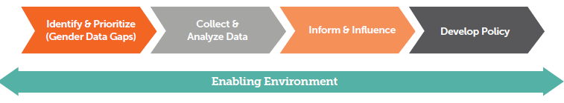
Data to policy: chronological stages
Across 18 country case studies:
Notes:
In chronological terms, we examined 4 major stages of data uptake:
Identify and Prioritize: Who were the main stakeholders involved in calling for and supporting TU data.
2. Collect and Analyze: How exactly was the data collected and analysed?
3. Inform and Influence: How did time use data findings get disseminated and by whom? What role did different actors (civil society, government, data producers) play?
4. Develop Policy & Monitor Progress: Did time use data findings directly or indirectly influence policies, and if not, what were some obstacles or constraints?

Slide 9
What has helped foster the data-to-policy link?
Identify and prioritize
Demand-driven data is more successful
Notes:
We found that throughout these stages, a number of approaches helped to foster the data-to-policy link.
Where time use data is demand driven and line ministries are involved from the beginning, the likelihood of use in public policies or programs is increased

Slide 10
What has helped foster the data-to-policy link?
Identify and prioritize
Collect and Analyze
High quality data = better chance of policy impact
Notes:
When high quality data is produced and analysis directly relates to policy concerns, data can directly and indirectly impact policy

Slide 11
What has helped foster the data-to-policy link?
Identify and prioritize
Collect and Analyze
Identify and prioritize
Effective communication is key
Notes:
Effectively communicating the findings was also key. Presentation of findings to country and international stakeholders - defining policy issues and questions, and coordinating role and support for stakeholders within countries

Slide 12
What has helped foster the data-to-policy link?
Identify and prioritize
Collect and Analyze
Identify and prioritize
Develop Policy
Multiple uses of data= Policy development, monitoring and evaluation
Notes:
Frequently produced data allows for both the development and monitoring and evaluation of policies. In addition, regional cooperation was found to be key in supporting both the creation and the use of data.

Slide 13
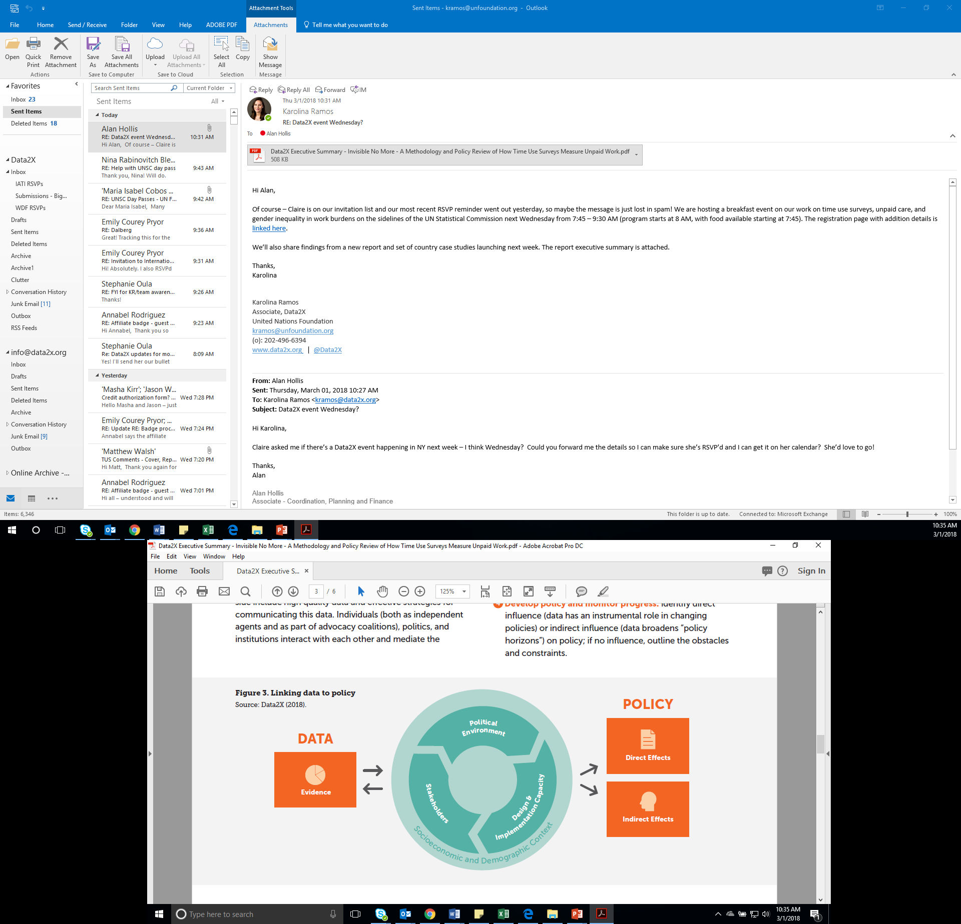
What are the steps to link data to policy?
Notes:
So, what are the steps to link data to policy? Our report devised the framework on screen. Assuming that the data produced is both high quality and supported by an effective communications strategy, the factors mediating the uptake of data into policy include the political environment, the actions and beliefs of stakeholders and the design and implementation capacity of data producers and users. Stakeholders influence and are influenced by the political environment, and policy makers’ priorities and beliefs, the timing of the data release in the political cycle and the strength of internal pressure and support all help determine the use of data. The institutions that translate the political will and use the data for defining policy or designing programs are the third element and the linchpin that actualizes the link between data and policy. We also found that data uptake depends on data literacy or capacity and overall data culture in the public sector and relevant private sector agencies.

Slide 14
Time use surveys’ role in policymaking – country studies
Direct policy effects:
Albania, Mexico
Cambodia , Colombia, Uruguay
Moldova
Finland
Used to define, monitor, or evaluate gender equality policies
Care policies
Employment policies for women, child care centers
Employment projects for rural women, early retirement policies, child/family policies, media and cultural programs
Notes:
We can see that the direct effects range from care policies to employment and social protection policies. In Moldova for example, the data was used to inform efforts to improve women’s LFP and setting up child care centers in the workplace; paternity leave. In Colombia, data on barriers to accessing childcare influenced expansion of an early childhood development program (De Cero a Siempre) which is on track to exceed its goal of caring for more than 1.5 million children. Many more examples of the important gaps in service provision and opportunities for improvement that Time Use data has uncovered are available in the report.
But we also found evidence of indirect effect such as the expansion of policy horizons, with data generating new policy debates, though not resulting in policy outcomes in the time period we examined. Significantly, we saw in many countries that the data had been used to construct household satellite accounts, but that while these may have broadened policy horizons, they have not led to direct policy impact. Largely this is related to the fact that household satellite accounts do not respond to a specific policy question and there are few models for policy responses to the notional value of women’s unpaid work that these accounts provide.

Slide 15
Conclusions
Unravelling the relationship between paid and unpaid work is crucial for economies: Time Use Data provides the missing link
Time Use Data has directly and indirectly impacted policy
But, TU data remains underproduced and underutilized
There are a number of factors that mediate data uptake
Policy-makers and data producers must work together to produce relevant and useful information in their context
Notes:
(Read text on slide)

