Slide 1
ASIA-PACIFIC TRAINING CURRICULUM ON GENDER STATISTICS
Multilevel disaggregation analysis to monitor the SDGs from a Leave No One Behind perspective

Slide 2
Introduction to multilevel disaggregation analysis to monitor the SDGs from a Leave No One Behind perspective (LNOB analysis)
1

Slide 3
LNOB analysis
LNOB analysis focuses on disaggregating data
Data disaggregation by sex and beyond
Deprivation due to overlapping discrimination between two variables
Deprivation due to overlapping discrimination between three variables
Deprivation due to overlapping discrimination between four variables
Overlapping forms of discrimination
Age
Sex
Geography
Managerial level
Sex
Geography
Sex
Sex
Marital status
Ethnicity
Geography
Religion
Migratory status
Ethnicity
Wealth quintile
Location
Ethnicity
Religion
Disability

Slide 4
LNOB analysis: Example of overlap for women in Mongolia
Wealth
1st Level Analysis
(only one variable)
Poorest ; Richest
Wealth
Location
2nd Level Analysis
(two variables)
Poorest Rural ; Richest Urban
Wealth
Location
Region
3rd Level Analysis
(three variables)
Poorest Rural Khangai; Richest Urban Ulaanbaatar
Wealth
Location
Ethnicity
Religion
4th Level Analysis
(four variables)
Poorest Rural Kazakh Muslim; Richest Urban Khalkh Buddhist

Slide 5
LNOB analysis

Slide 6
LNOB analysis: Education among women and girls in Mongolia (MICS 2013–14)
52%
52% Poorest Rural Kazakh
The poorest rural Kazakh women and girls are over 50 TIMES as likely as the richest urban Khalkh women and girls to be deprived of education
Proportion of women and girls with primary or less years of education in Mongolia
29% Poorest
19% Rural; Khalkh
8% National Aggregate
7% Urban
0%
3% Urban
0% Richest; Richest Urban Khalkh

Slide 7
2
LNOB analysis methodology

Slide 8
Framework for LNOB analysis
Get the right raw data
Microdata
Sample representative of all groups
Select disaggregation variables
Based on previous knowledge of disadvantages
Based on trial for different indicators
Conduct analysis
Calculate SDG indicators (or similar)
Simultaneously disaggregate data using selected variables
Large enough sample size
Use the results
Design universal policies that ensure reach to the most disadvantaged
Knock-on effect on SDG achievement
Measure again
Content analysis of policy documents

Slide 9
1. Get the right microdata
Sample size
Sample size and method is representative of various population groups
Household surveys with large representative samples, as well as census data, are well suited
Some surveys suitable for LNOB analysis are:
Demographic and Health Survey (DHS)
Who is interviewed?
Surveys that collect data at the individual level rather than household level
Specific questionnaires addressed to women
e.g. Issues of violence by intimate partner, contraceptive use, decision-making
Multiple Indicator Cluster Survey (MICS)
Timeliness and periodicity of data
Data that is frequently collected
Data that is released in a timely manner
Labour Force Survey (LFS)
Living Standards Measurement Survey (LSMS)
International comparability
Standardized survey instruments are recommended for LNOB analysis, if comparisons across countries are desired

Slide 10
1. Get the right microdata
- Examples of SDG-related (or proxy) indicators can be calculated with DHS and MICS
SDG | Indicator | Data source
SDG 2: End hunger, achieve food security and improved nutrition and promote sustainable agriculture | Proportion of women aged 18–49, who are underweight (BMI less than 18.5 kg/m² ) | DHS: IR file MICS: wm file
SDG 3: Ensure healthy lives and promote well-being for all at all ages | Proportion of births attended by skilled health personnel (births in last five years) | DHS: BR file MICS: wm file
SDG 4: Ensure inclusive and equitable quality education and promote lifelong learning opportunities for all | Proportion of women and girls aged 15–49 with primary or less years of education | DHS: IR file MICS: wm file
SDG 5: Achieve gender equality and empower all women and girls | Proportion of women aged 18–49 who were married before age 18 | DHS: IR file MICS: wm file
SDG 6: Ensure availability and sustainable management of water and sanitation for all | Proportion of women and girls aged 15–49 with access to basic drinking water services | DHS: IR file MICS: wm file + hh file
 | Proportion of women and girls aged 15–49 with access to basic sanitation services | DHS: IR file MICS: wm file + hh file
SDG 7: : Ensure access to affordable, reliable, sustainable and modern energy for all | Proportion of women and girls aged 15–49 with access to clean cooking fuel | DHS: IR file MICS: wm file
SDG 8: Promote sustained, inclusive and sustainable economic growth, full and productive employment and decent work for all | Proportion of women aged 18–49 currently not employed | DHS: IR file MICS: wm file
SDG 11: Make cities and human settlements inclusive, safe, resilient and sustainable | Proportion of women and girls aged 15–49 living in overcrowded housing | DHS: PR file + IR file MICS: wm file

Slide 11
2. Select disaggregation variables and priority areas
First step is to identify the research question
LNOB question:
Which population groups are lagging behind, and for which development indicators?
Vulnerable population groups and development issues vary from country to country
How to identify vulnerable groups and priority areas in each country?
ANALYSIS OF NATIONAL STRATEGIES
(e.g. using EPIC (Every Policy Is Connected) tool, UN-ESCAP)

Slide 12
2. Select disaggregation variables and priority areas: Using EPIC
EPIC facilitates dialogue between data users and data producers
EPIC provides practical guidance to examine national policies and:
Identify target groups, groups lagging behind
Identify priority thematic areas
Identify development indicators to monitor progress for the priority areas and target groups
Using EPIC for LNOB:
See EPIC here: https://www.unescap.org/sites/default/files/EPIC%20Overview%20%28EPIC_V1.1_Final%29.pdf
Hold multi-stakeholder consultation
Content-analyse existing gender-relevant policy documents
Map relevant existing indicators
Conceptual framework analysis

Slide 13
2. Select disaggregation variables and priority areas: Using EPIC
Hold multi-stakeholder consultations:
Dialogue between data users and producers
Collaboration to identify key thematic priorities and key target (population groups) in each country
Policymakers at national/sectoral/local level should lead the discussion to identify areas and groups
Support from planning and budgeting organizations to identify areas and groups
NSOs should guide policymakers in identifying indicators for priority areas and groups
Other data producers and line ministries can assist the NSO in its development of indicators

Slide 14
2. Select disaggregation variables and priority areas: Using EPIC
Content-analyse existing policy documents (e.g. national development strategies, national gender strategies, etc.)
Policymakers need to lead the review of policy documents
Identify key priority areas, identify target groups
Example: India’s Niti Ayog 3-year Action Agenda (2017)
Key priority issue
“In order to reduce drop-out rates especially among girls belonging to Scheduled Tribe communities, hostel facilities must be ensured in all areas in which they are currently absent. Moreover, where facilities exist, they need to be upgraded and maintained so that they are usable. State Governments are currently eligible for 100% funding for establishment of all Ashram Schools for girls as well as Ashram Schools for boys in areas that are Naxalite affected”
Target groups
Potential disaggre-gation variables
Sex
Potential indicators should relate to
Caste
School dropouts
Region
Student lodging

Slide 15
2. Select disaggregation variables and priority areas: Using EPIC
Map priority issues with relevant existing indicators at national/regional/global levels
Taking the same example:
National Indicator Framework, India
1.a.2 : Proportion of total government spending on essential services (education, health and social protection)
4.1.7 : Out of school ratio (primary, upper primary, elementary, secondary and higher secondary)
4.1.1 : Net Enrolment Ratio in primary and upper primary education
4.1.2 : Adjusted Net Enrolment Ratio in primary, upper primary and secondary education
4.1.3 : Gross Enrolment Ratio in higher secondary education
4.3.2 : Proportion of women and girls and men and boys enrolled in higher education, technical and vocational education
4.6.1 : Literacy rate of youth in the age group of 15–24 years.
SDG Global Indicator Framework
Indicator 4.1.1: Proportion of children and young people: (a) in grades 2/3; (b) at the end of primary; and (c) at the end of lower secondary achieving at least a minimum proficiency level in (i) reading and (ii) mathematics, by sex
Indicator 4.2.2: Participation rate in organized learning (one year before the official primary entry age), by sex
Indicator 4.3.1: Participation rate of youth and adults in formal and non-formal education and training in the previous 12 months, by sex
Indicator 4.5.1: Parity indices (women/men,, rural/urban, bottom/top wealth quintile and others such as disability status, indigenous peoples and conflict-affected, as data become available) for all education indicators on this list that can be disaggregated

Slide 16
2. Select disaggregation variables and priority areas: e.g. Underweight women
DEPRIVATIONS are most acutely felt by women facing multiple forms of discrimination simultaneously
To LNOB, data disaggregation is needed at multiple levels and for various indicators
For example: To measure the likelihood of people to be underweight (as proxy for undernourishment)
Data disaggregation
Rationale
Example of research question
Disaggregation by sex
To identify whether undernourishment rates vary between women and men
Are women in Nepal more likely to be underweight than men?
Disaggregation by location
To identify how undernourishment rates vary between urban and rural populations
Are rural people more likely to be underweight than urban people in Nepal?
Disaggregation by sex and location simultaneously
To see the combined effect of discrimination based on sex and location of residence, regarding one’s likelihood to be underweight
Are rural women more likely to be underweight than urban women in Nepal?

Slide 17
3. Conduct analysis: To calculate the proportion of women and girls who are currently underweight
Stages of LNOB analysis
Part 1: Computing the indicator of interest
Part 2: Disaggregating the indicator by multiple socioeconomic factors relevant in the national context
Part 3: Comparing groups lagging behind across multiple indicators
Part 4: Identifying the total population who lags behind consistently across multiple indicators

Slide 18
3. Conduct analysis: To calculate the proportion of women and girls who are currently underweight
What is needed to conduct LNOB analysis?
- DHS, MICS or any other survey that captures Body Mass Index at the individual level
Microdata
- Microdata that pertains specifically to women (e.g. Individual Recode File (IR File) for DHS Survey)
- Sample is representative of the population groups of interest
Statistical software
- Stata, SPSS, SAS, R
Metadata
- Refer to the global SDG Metadata Repository (UNSD)
- Understand definitions, methods of computation, recommended data sources, potential limitations

Slide 19
3. Conduct analysis: To calculate the proportion of women and girls who are currently underweight
Before conducting the LNOB analysis, understand the indicator metadata
- According to the SDG metadata, women aged 18–24 years
Who is the target group?
- But for LNOB analysis, we use 18–49 years (larger sample size needed for data disaggregation at multiple levels)
- Selection of age group depends on policy priorities, indicator metadata and sample size
- To assess those ‘underweight’ purely as a result of undernourishment or lack of adequate nutritional needs
Is there any group of women we must exclude?
- Exclude pregnant women or those women whose pregnancy terminated less than 3 months prior to the survey
What is the definition of underweight?
- Body Mass Index (BMI) of less than 18.5 for an adult person (WHO guidelines)

Slide 20
3. Conduct analysis: To calculate the proportion of women and girls who are currently underweight
Important DHS weight variables to conduct LNOB analysis:
Unit of analysis | Weight variable
Households | hv005
Household members | hv005
Women | v005
Domestic violence | d005
Men | mv005
Sample weights are calculated to 6 decimal places in DHS surveys.
Thus, use weights in the following format:
iw=v005/1000000

Slide 21
3. Conduct analysis: To calculate the proportion of women and girls who are currently underweight
LNOB Checklist
Indicator metadata
Definition, exclusion criteria
Now, you are ready for LNOB analysis!
Microdata (DHS/MICS)
Statistical analysis software (Stata)
Sampling/Sampling weights

Slide 22
3. Conduct analysis: Part 1 Computing the indicator of interest
Part 1: Computing the indicator of interest
Download the country specific microdata. For this example we will use DHS or MICS
Select the IR file for Stata
Select the file format that is compatible with your statistical analysis software

Slide 23
3. Conduct analysis: Part 1 Computing the indicator of interest
Open the dataset utilizing STATA
If Stata shows error message “no room to add more variables”, type
set maxvar 35000
To inform Stata about the nature of the dataset (in this case, a survey dataset), type
svyset v021 [pweight=v005], strata (v022), where:
v021 = Primary Sampling Unit (PSU)
v022= Strata
pweight= Probability weight (equal to women’s individual sample weight (v005)

Slide 24
3. Conduct analysis: Part 1 – Computing the indicator of interest
To calculate the proportion of women and girls who are currently underweight, follow this series of data manipulation:
Consider the entire sample of women in the IR file
Keep only women and girls aged 15–49 years
(use age variable v012)
Remove currently pregnant women
(use pregnancy status variable v213)
Keep only women whose pregnancy has terminated less than 3 months prior to the survey
(use variable v233)
BMI is used as proxy for undernourishment
(use BMI variable v445)

Slide 25
3. Conduct analysis: Part 1 – Computing the indicator of interest
To keep only women in the age group 18–49
keep if v012>17
drop if v012>49
v012 is the recode variable for woman’s current age
To drop currently pregnant women
drop if v213==1
v213 is the recode variable for pregnancy status, where ‘Yes’ response is recoded as 1woman’s current age
To only keep women whose pregnancy terminated more than 3 months prior to survey
keep if v233>3
v233 is the recode variable for ‘months when pregnancy ended’
Generate a new variable named ‘underweight’
generate underweight=0
Replace the value of 0 with 1 if woman is underweight
replace underweight=1 if v445<1850
v445 is the recode variable for body mass index. 1850 corresponds to a BMI of 18.5
Treat missing values by replacing with a dot (.)
replace underweight=1 if v445==.|v213==.|v012==.

Slide 26
3. Conduct analysis: Part 1 – Computing the indicator of interest
Tabulate the results using appropriate sample weights
tab underweight [iw=v005/1000000]
v005 is the recode variable for women’s sample weight
Results table showing proportion of underweight women and girls in Nepal, DHS 2016
Nearly 16% of women aged 15–49 years are underweight in Nepal (DHS 2016)

Slide 27
3. Conduct analysis: Part 2 – Disaggregate data by contextually relevant variables
Part 2: Disaggregate data by contextually relevant variables
Some drivers of inequality in Nepal
Region
Religion
Ethnicity
Wealth quintile
Location

Slide 28
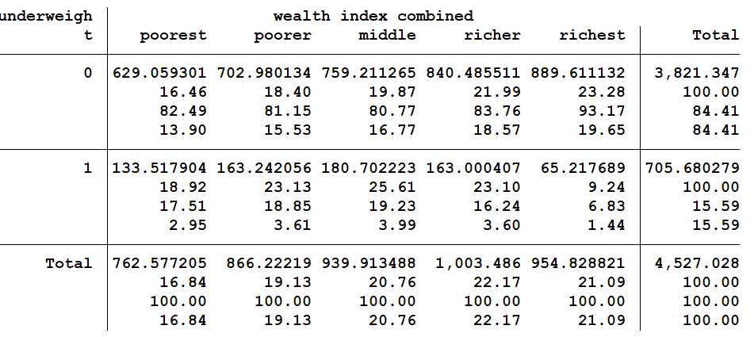
3. Conduct analysis: Part 2 – Disaggregate data by contextually relevant variables
Wealth Quintile
Poorest
(bottom 20%)
Poorer
Middle
Richer
Richest
(top 20%)
Disaggregate data by wealth
v190 is the variable for wealth index
tab underweight v190 [iw=v005/1000000], cell column row

Slide 29
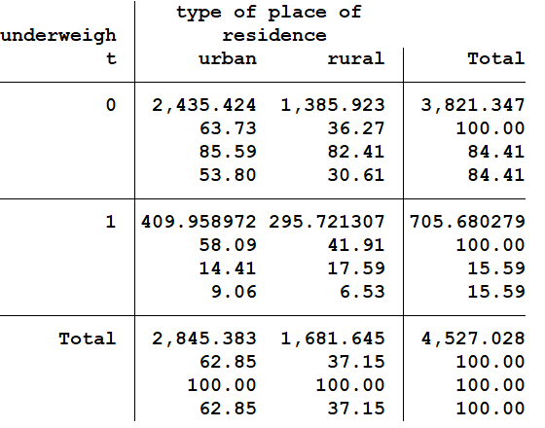
3. Conduct analysis: Part 2 – Disaggregate data by contextually relevant variables
Location
Rural
Urban
Disaggregate data by Location
v025 is the variable for location of residence
tab underweight v025 [iw=v005/1000000], cell column row

Slide 30
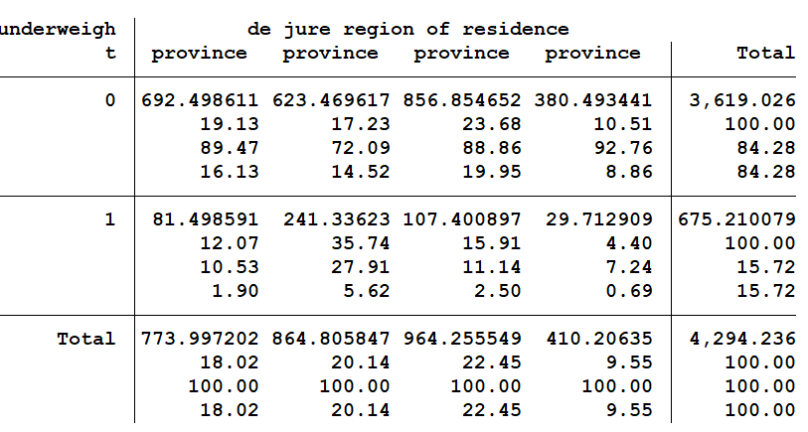
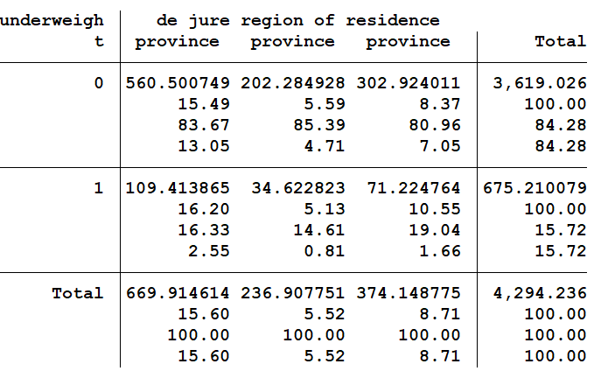
3. Conduct analysis: Part 2 – Disaggregate data by contextually relevant variables
Region
Province 1
Province 2
Province 3
Province 4
Province 5
Province 6
Province 7
Disaggregate data by Region
drop if v139==97
tab underweight v139 [iw=v005/1000000], cell column row
v139 is the variable for region of residence where value 97 represents non-de-jure residents

Slide 31
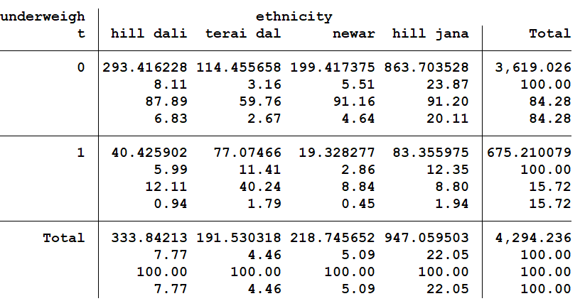
3. Conduct analysis: Part 2 – Disaggregate data by contextually relevant variables
Ethnic groups
Hill brahmin
Newar
Hill chhetri
Terai brahmin/chhetri
Other terai caste
Hill dalit
Terai dalit
Hill janajati
Terai janajati
Muslim
Disaggregate data by Ethnicity
v131 is the variable for Ethnicity
tab underweight v131 [iw=v005/1000000], cell column row

Slide 32
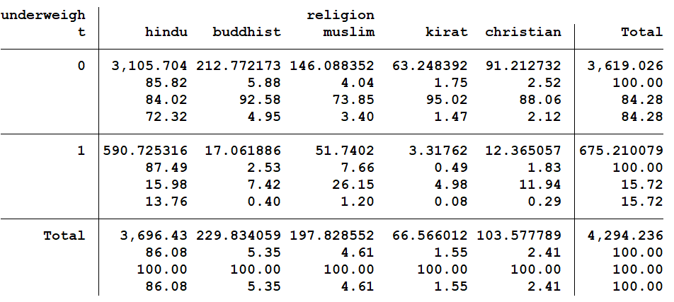
3. Conduct analysis: Part 2 – Disaggregate data by contextually relevant variables
Religious groups
Hindu
Buddhist
Muslim
Kirat
Christian
Disaggregate data by Religion
v131 is the variable for religion
tab underweight v130 [iw=v005/1000000], cell column row

Slide 33
3. Conduct analysis: Part 2 – Disaggregate data by contextually relevant variables
Proportion of women ages 18–49 who are underweight, by wealth, location, region, ethnicity and religion, in Nepal (DHS 2016)

Slide 34
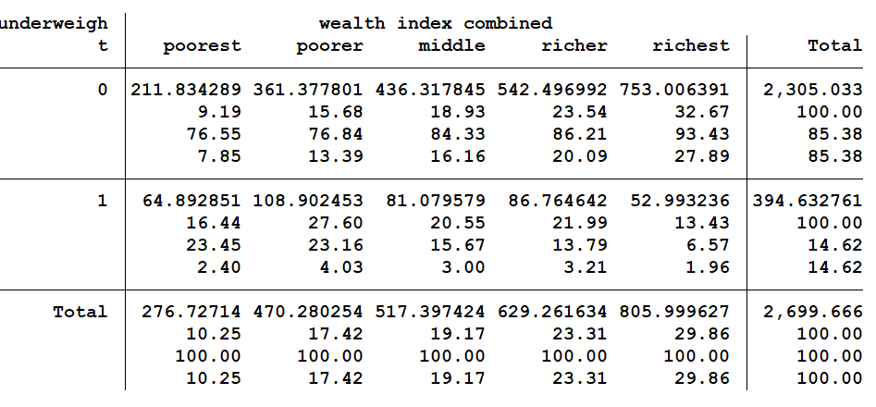
3. Conduct analysis: Part 2 – Disaggregate data by contextually relevant variables
v025= variable for location
v190= variable for wealth
Disaggregate by Wealth and Location
by v025, sort: tab underweight v190 [iw=v005/1000000], cell column row
Estimates for proportion of underweight women in URBAN regions across different wealth groups in Nepal (DHS 2016)
Estimates for proportion of underweight women in RURAL regions across different wealth groups in Nepal (DHS 2016)

Slide 35
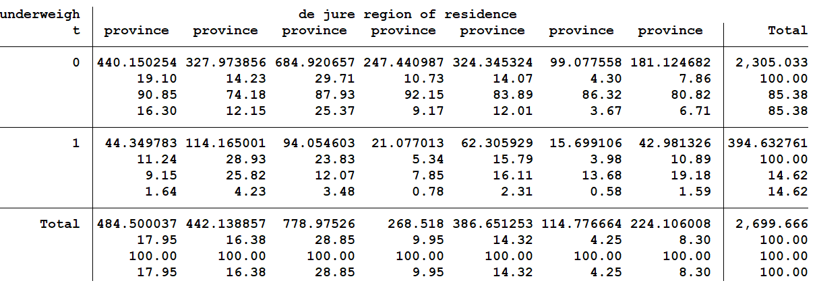
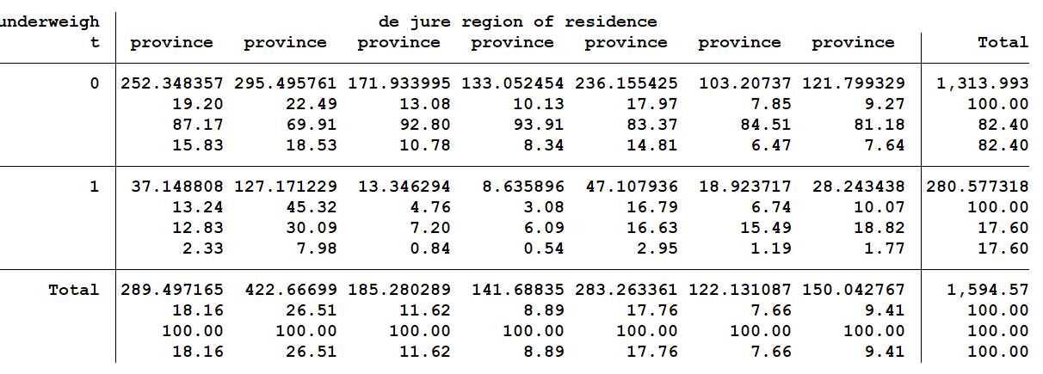
3. Conduct analysis: Part 2 – Disaggregate data by contextually relevant variables
v025= variable for location
v139= variable for region
Disaggregate by Region and Location
drop if v139==97
by v025, sort: tab underweight v139 [iw=v005/1000000], cell column row
Proportion of URBAN women who are underweight, across different regions in Nepal (DHS 2016)
Proportion of RURAL women who are underweight, across different regions in Nepal (DHS 2016)

Slide 36
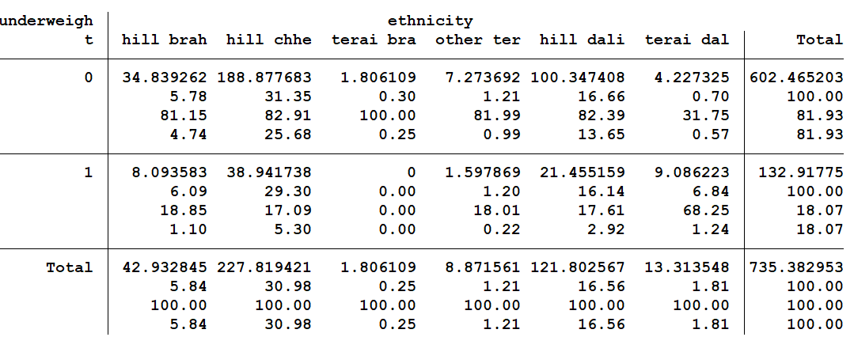
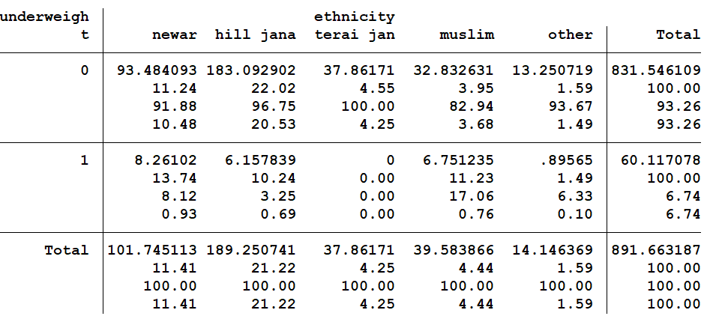
3. Conduct analysis: Part 2 Disaggregate data by contextually relevant variables
v131= variable for ethnicity
v190= variable for wealth
Disaggregate by Wealth and Ethnicity
by v131, sort: tab underweight v190 [iw=v005/1000000], cell column row
Proportion of POOREST women and girls who are underweight across different ethnic groups in Nepal (DHS 2016)
Proportion of RICHEST women and girls who are underweight across different ethnic groups in Nepal (DHS 2016)
Sample size less than 40 can provide unreliable estimates

Slide 37
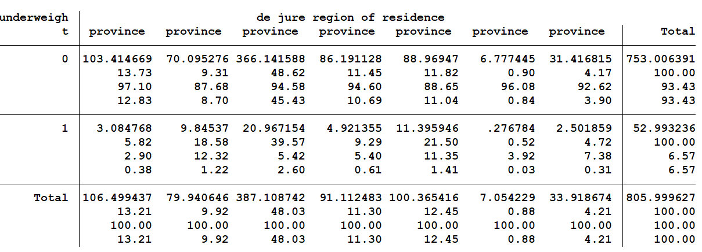
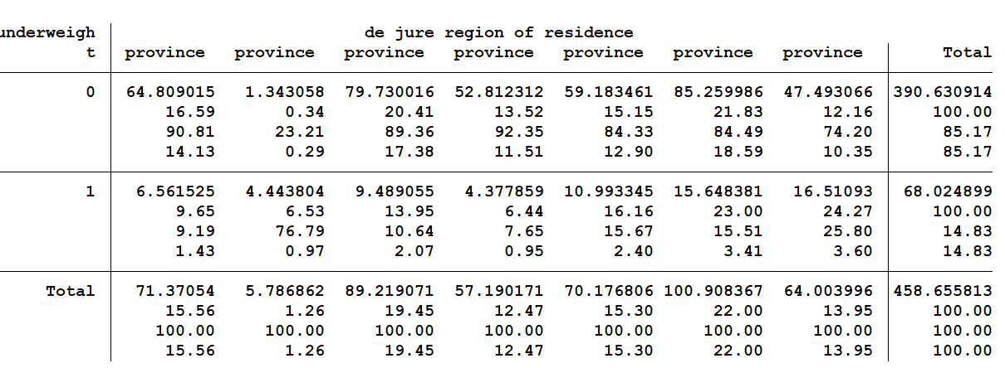
3. Conduct analysis: Part 2 – Disaggregate data by contextually relevant variables
- Data disaggregation by wealth, location and region
v025==1 (Urban)
v025==2 (Rural)
drop if v139==97
by v190, sort: tab underweight v139 [iw=v005/1000000] if v025==1, cell column row
by v190, sort: tab underweight v139 [iw=v005/1000000] if v025==1, cell column row
Proportion of URBAN RICHEST women and girls who are undernourished in Nepal (DHS 2016)
Proportion of RURAL POOREST women and girls who are undernourished in Nepal (DHS 2016)

Slide 38
3. Conduct analysis: Part 2 – Disaggregate data by contextually relevant variables
Proportion of women ages 18-49 who are underweight, by wealth, location, and region and the compound of the three, in Nepal (DHS 2016)

Slide 39
3. Conduct analysis: Part 3 Identifying the total population who lags behind consistently across multiple indicators
SDG 3
Proportion of births not attended by skilled health personnel
SDG 4
Proportion of women and girls ages 15–49 with primary or less years of education
SDG 5
Proportion of women ages 18–49 who were married or in a union before age 18
SDG 6
Proportion of women and girls ages 15–49 with no access to basic drinking water services
SDG 6
Proportion of women and girls ages 15–49 with no access to basic sanitation facilities
SDG 7
Proportion of women and girls ages 15–49 with primary reliance on unclean cooking fuel
SDG 8
Proportion of women ages 18–49 currently not employed
SDG 11
Proportion of women and girls ages 15–49 living in overcrowded housing
The same analysis should be repeated for different SDG or related indicators

Slide 40
3. Conduct analysis: Part 3 Identifying the total population who lags behind consistently across multiple indicators
Inequality in SDG-related outcome areas across different groups in Nepal (DHS 2016)

Slide 41
3
Testing the significance of LNOB results

Slide 42
Testing the significance
Proportion of richest women and girls who have primary or less years of education=31.16%
Is this difference statistically significant?
Proportion of poorest women and girls who have primary or less years of education=86.80%
Test of proportions: Conduct the two-sample test of proportions using variables ‘prtest’ in STATA to test the statistical significance between proportion of richest and poorest women and girls who have primary or less years of education
$$H_{0}=There is no difference in the proportions of richest and poorest women and girls who have primary or less years of education$$
i.e. $P_{primaryorlesspoorest}=P_{primaryorlessrichest }$

Slide 43
Testing the significance
Primary or less years of education
generate primaryorless=0
replace primaryorless=1 if v133<7
Poorest group of women and girls
generate poorest=0
replace poorest=1 if v190==1
replace poorest=. if v190==.
Poorest group of women and girls with primary or less years of education
generate poorestprimaryorless=0
replace poorestprimaryorless=1 if poorest==1 & primaryorless==1
replace poorestprimaryorless=. if poorest!=1
replace poorestprimaryorless=. if primaryorless==.
Richest group of women and girls
generate richest=0
replace richest=1 if v190==5
replace richest=. if v190==.
Richest group of women and girls with primary or less years of education
generate richestprimaryorless=0
replace richestprimaryorless =1 if richest==1 & primaryorless==1
replace richestprimaryorless =. if richest!=1
replace richestprimaryorless =. if primaryorless==.

Slide 44
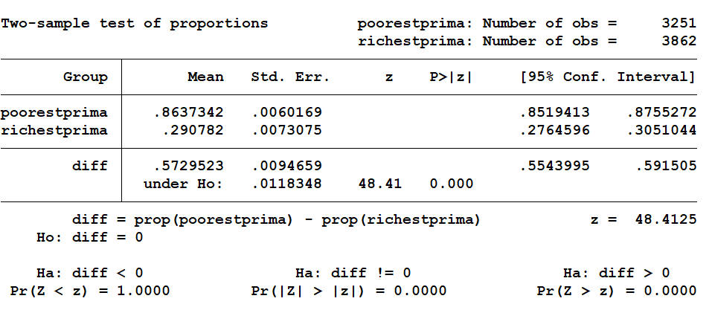
Testing the significance using STATA
Run the two-sample test of proportions to test the significance of difference between poorest and richest group
prtest poorestprimaryorless=richestprimaryorless

Slide 45
Testing the significance using STATA
Summary of results:
Parameters | Meaning | Value | Interpretation
z-score | A measure of how many standard deviations below or above the population mean a raw score is. | 48 | The obtained difference in the proportions between the richest and poorest is 48 standard deviations away from the hypothesized difference of 0. A z-score this high indicates that a difference of .57 between the poorest and richest groups is very unlikely to have happened by chance.
P value | The p-value or probability value is the probability of obtaining test results at least as extreme as the results actually observed during the test under the assumption that H₀ is true. | 0.00 | Since the z score of 48 has been obtained at a p value of 0.00, which is less than 0.05, we can reject the null hypothesis that our two groups were not different.
Confidence interval | A confidence interval refers to the probability that a population parameter will fall between two set values for a certain proportion of times. | .5543 to .5915 | The 95 per cent confidence interval indicates that we are 95% confident that the difference in the proportions between the poorest and richest groups of women with primary or less years of education in Bangladesh lies between this range.

Slide 46
4
Reporting LNOB estimates

Slide 47
Reporting LNOB estimates
Consistently utilize LNOB estimates to review the implementation of national policy priorities/national strategies.
Ensure that national SDG databases, gender databases, or any other relevant data repositories showcase information at various levels of disaggregation.
Include LNOB estimates in survey reports, monitoring reports and strategy/policy progress reports.
Ensure LNOB estimates are also reported to the international statistical system. Although some global repositories do not allow for disaggregation for all indicators, others (such as the SENDAI Monitor, for instance) do offer the possibility of uploading disaggregated data, if desired.
Communicate LNOB estimates to journalists, CSOs and the general public through the use of infographics, written media stories and audiovisuals. Ensure the message is tailored to convey the information efficiently and in a way that is easily understood by non-expert audiences (refer to Modules 10 and 11 of this Training Curriculum to know more about this).

Slide 48
5
Key takeaways

Slide 49
Key takeaways
LNOB analysis should begin with examining national policies/strategies to identify:
Key priority thematic areas (e.g. development indicators)
Key priority population groups (e.g. disaggregation variables)
Disaggregating data by sex is important to reveal the inequalities between men and women. In addition, disaggregating data by variables such as location, region and ethnicity, helps identify the most deprived population groups.
Repeating multiply disaggregated analysis for various indicators often reveals that the same population groups are consistently deprived across most areas (or indicators).
Household surveys are a good source of microdata for this analysis, IF they interview women in the household directly and the sample is representative of the priority population groups.
To disaggregate data at multiple levels, it is very important to keep an eye on the sample size.
When calculating estimates for an indicator in Stata or any other software, always use sample weights to interpret results accurately.
Read the metadata to understand the definitions, computation methods and caveats of the indicators and data before starting the analysis.
Test for significance of results at a 95% or 99% significance level:
Use the ‘prtest’ to test the significance of difference between two-sample proportions.
Use the z statistic to test the significance of difference between the proportion of two-sample.

Slide 50
Thank you

