Slide 1
ASIA-PACIFIC TRAINING CURRICULUM ON GENDER STATISTICS
Analyzing data with a gender angle

Slide 2
Understand the need to go beyond descriptive statistics to disentangle the multidimensional aspects of gender statistics
Gain hands-on experience in analyzing microdata from Multiple Indicator Cluster Survey (MICS6)
Become familiar with logistic regression analysis to analyze categorical responses in household surveys
1
Learning objectives

Slide 3
Sources of data for gender analysis
- Household surveys such as Demographic and Health Surveys (DHS), Multiple Indicator
Cluster Surveys (MICS), Labour Force Surveys (LFS), Household Income and Expenditure
Surveys (HIES) and others
Censuses provide key variables related to women and girls in entire geographical units of the
country but most censuses are conducted every 10 years, due to complexity and high cost.
- Administrative records (e.g. school records, civil registries, etc.) are becoming increasingly
popular as alternative sources of data for gender analysis. However, there are challenges of
addressing the quality of the administrative records (e.g. coverage issues such as underreporting).

Slide 4
What is MICS?
- The Multiple Indicator Cluster Survey (MICS) collects sample data in numerous areas, including education, health, child protection, sanitation and other data required for the compilation of SDG indicators.
Developed by UNICEF in the 1990s and more than 300 surveys have been carried out in over 100
countries.
- The questionnaires are standardized and are very similar to those of Demographic and Health Surveys.
- The latest (round six) results of microdata are available for completed surveys and they can be
downloaded at MICS homepage (free of charge).

Slide 5
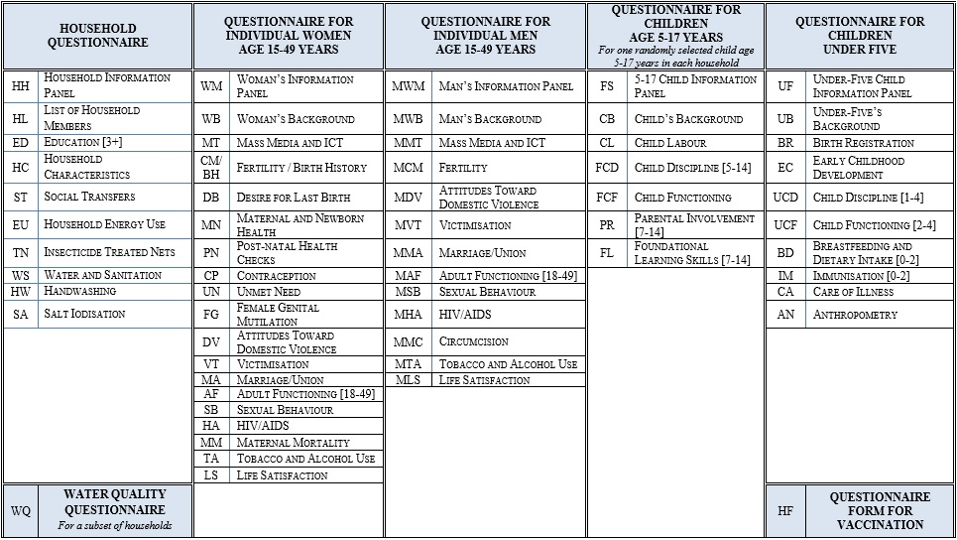
Questionnaires and modules of MICS6
Source: MICS website (https://mics.unicef.org/tools)

Slide 6
Analyzing factors that influence attitudes toward domestic violence
- MICS has questions that can be used to measure attitudes towards domestic violence
- What are the factors that influence the attitudes of women and men towards domestic violence?
Source: MICS questionnaire for individual women (https://mics.unicef.org/tools)

Slide 7
Getting ready for statistical analysis
Consolidating five questions into a single variable: Response variable (also known as dependent variables)
    coded “1” if at least one the five questions have a “yes”
    coded “0” otherwise
Do different levels of wealth, age, education, place of residence (urban/rural) or marital status have any influence on attitudes towards domestic violence?
(explanatory variables are also known as independent variables)
Response variables and explanatory variables are scattered across several questionnaires, which requires merging of datasets by using key variables that are common in all questionnaires.

Slide 8
Considering sampling design and sample weights
MICS6 data (Mongolia) takes a two-stage stratified cluster sampling approach which is very common in many household surveys.
    First stage: 4,444 clusters (PSUs)
    Second stage: sample of 889,817 households selected
Any analysis that involves estimation of standard errors, confidence intervals or significance testing, it is important to consider the complex sample design parameters, such as the primary sampling units (PSUs), the stratification variable and the sampling weights.
R has a ‘survey’ package that performs analysis for multistage stratified cluster samples.
STATA allows users to perform this analysis by utilizing the command ‘SVY’.

Slide 9
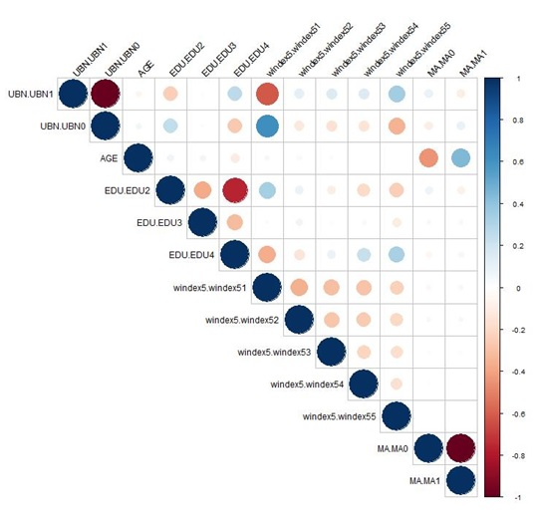
Correlation between the variables
Do place of residence (urban or rural) and wealth have any relationship? How about education and wealth? If there is a pattern between them, is it a positive or a negative relationship? Correlation is a useful numerical summary of the strength of a relationship between two variables ranging from -1 to 1.

Slide 10
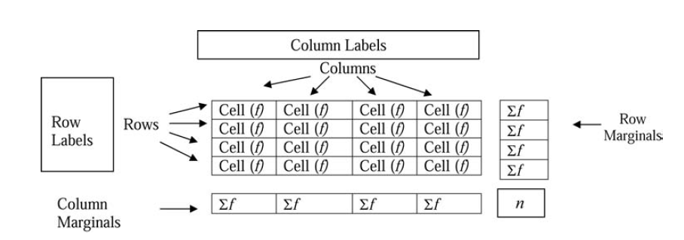
Cross tabulation
Cross tabulation are tables that group variables to assess the relationships between them
It is necessary to decide, which of the two is the independent and which is the dependent variable, when doing cross tabulation
The most widely used convention is to use the row for the independent variable; and the column for the dependent variable

Slide 11
One way table
A one-way table shows relative frequencies of a single categorical variable
When a one-way table shows relative frequencies, the sum of the column should equal to one
If the relative frequencies are multiplied by 100, then it becomes percentages, i.e. the sum of the column should equal to 100
Interpretation: 50% of the clients prefer to travel to the USA, whereas 30% of clients want to travel to Europe and 20% of clients want to travel to Asia.

Slide 12
Two way table
A two-way table examines the relationship between two categorical variables.
Entries in the cells can be displayed as frequency counts or as relative frequencies
The table shows the favorite leisure activities for 50 adults (20 men and 30 women)
Entries in the Total (Column) and Total (Row) are called marginal frequencies. They should have the same sum (i.e. 50)
Entries in the body of the table are called joint frequencies.
- Looking at the marginal frequencies, we might conclude that the three activities had roughly equal appeal. Yet, the joint frequencies show a strong preference for dance among women; and little interest in dance among men.

Slide 13
Two way frequency table (proportion)
The following tables relative frequencies (proportions) for the whole table
The denominator used is 50 as it is the total count of observations in the table
Interpretation: 36% of the respondents prefer dancing, 32% of them prefer doing sports and 32% of them prefer watching TV.

Slide 14
Two way frequency table (Row)
The table above shows the row percentages
They were derived by dividing the count for each cell (joint frequency) by the total number of observations in each row
The row percentages showed the preferred activities (column categories) among women and men (observations in row) as percentages
Interpretation: the most preferred activity among women is dancing (53%), whereas sports are the least preferred activity among women (20%). However, for men, the most preferred activity is doing sports, whereas dancing is the last preferred activity (10%).

Slide 15
Two way frequency table (column)
The table above shows the column percentages
They were computed by dividing the count for each cell (joint frequency) by the total number of observations in each column.
The column percentages showed the distribution (as percentages) of observations in each column (women and men) among those in the column (preferred activity).
Interpretation: more women (89%) than men (11%) prefer dancing. For doing sports, more men prefer (63%) it than women (38%). As for TV, equal proportions of women and men prefer this activity (50% respectively)

Slide 16
Cross tabulations (DV and Education)
The proportion of accepting attitudes towards domestic violence is lowest (8.6%) among women with the highest educational level (EDU=4) and highest (18.4%) among women with the lowest educational level (EDU=2)
STATA
R
colPercents(svytable(~DV+EDU, wm5design,round=TRUE))
## EDU
## DV 2 3 4
## 0 81.6 82.7 91.4
## 1 18.4 17.3 8.6
## Total 100.0 100.0 100.0
## Count 4338.0 1185.0 5144.0

Slide 17
Cross tabulations (DV and Wealth)
The proportion of women accepting attitudes towards domestic violence steadily decreases (23.5% to 6.7%) as we move from the bottom (windex5=1) to top (windex5=5) wealth quintile.
STATA
R
colPercents(svytable(~DV+windex5, wm5design,round=TRUE))
## windex5
## DV 1 2 3 4 5
## 0 76.5 84.4 85.6 90.8 93.3
## 1 23.5 15.6 14.4 9.2 6.7
## Total 100.0 100.0 100.0 100.0 100.0
## Count 1929.0 1970.0 2215.0 2218.0 2336.0

Slide 18
Cross tabulations (DV and Urban)
The proportion of women living in urban areas (UBN=1) accepting attitude towards domestic violence (10.9%) is lower than their counterparts residing in rural (UBN=0) areas (19.6%)
STATA
R
colPercents(svytable(~DV+UBN, wm5design,round=TRUE))
## UBN
## DV 1 0
## 0 89.1 80.4
## 1 10.9 19.6
## Total 100.0 100.0
## Count 7454.0 3214.0

Slide 19
Cross tabulations (DV and Marital Status)
The proportion of women not in a union (MA=0) accepting attitudes towards domestic violence (15.8%) is slightly higher than the proportion among women in a union (MA=1, 12.6%).
STATA
R
colPercents(svytable(~DV+MA, wm5design,round=TRUE))
## MA
## DV 0 1
## 0 84.2 87.4
## 1 15.8 12.6
## Total 100.0 100.0
## Count 3016.0 7652.0

Slide 20
Cross tabulations (Urban and Wealth)
Most of the women in the bottom wealth quintile (windex5=1) live in rural (UBN=0) areas (95.7%) whereas that same figure is only 0.1% for the women in the top wealth quintile. (windex5=5)
STATA
R
colPercents(svytable(~UBN+windex5, wm5design,round=TRUE))
## windex5
## UBN 1 2 3 4 5
## 1 4.3 71.7 80.9 82.6 99.9
## 0 95.7 28.3 19.1 17.4 0.1
## Total 100.0 100.0 100.0 100.0 100.0
## Count 1929.0 1970.0 2215.0 2218.0 2337.0

Slide 21
Cross tabulations (Wealth and Education)
Women with the highest educational level (EDU=4) has the highest proportion (37.7%) that falls in the top wealth quintile (windex5=5)
STATA
R
colPercents(svytable(~windex5+EDU, wm5design,round=TRUE))
## EDU
## windex5 2 3 4
## 1 33.6 22.1 4.1
## 2 25.4 26.7 10.8
## 3 20.5 22.6 20.6
## 4 13.6 21.1 26.8
## 5 7.1 7.5 37.7
## Total 100.2 100.0 100.0
## Count 4339.0 1185.0 5145.0

Slide 22
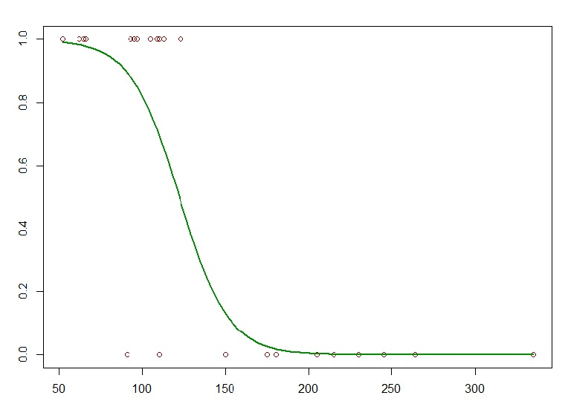

Logistic regression analysis
Y = Binary categorical response (yes or no)
X = continuous or categorical
π = proportion of 1’s (yes, success) at any X

Slide 23
Interpretation of logistic regression output
Having the highest educational level (EDU4) decreases the log odds of accepting attitudes towards domestic violence (DV), versus the reference group with secondary school education (EDU2), by 0.47641, holding the wealth and marital status variables constant (or the odds of DV decrease by 1-exp(-0.47641)=37.9%).
Having marital status of ‘married/living with partners’ (MA1) decreases the log odds of accepting attitudes towards domestic violence (DV), versus the reference group with marital status of ‘not in union’ (MA0), by 0.32699, holding the education and wealth variables constant (or the odds of DV decrease by 1-exp(-0.32699)=27.9%).
Belonging to the top wealth quintile (windex55) decreases the log odds of accepting attitudes towards domestic violence (DV), versus the reference group with bottom wealth quintile (windex51), by 1.14565, holding the education and marital status variables constant (or the odds of DV decrease by 1-exp(-1.14565)=68.2%).

Slide 24
R vs. STATA
R is free
R is well-supported by abundant sources of online help and community
    R-Bloggers
    StackOverflow
You can download and install R at Comprehensive R Archive Network (CRAN)
http://www.r-project.org
STATA is relatively affordable
It is widely used by NSOs, academics and other users
STATA is easier to use
The STATA online forum includes numerous Q&As as well as experts ready to help, who usually provide responses to queries in 24 hours.

Slide 25
ANALYSIS WITH STATA

Slide 26
Step 1: reading micro-data into STATA
// reading MICS microdata into STATA
// reading microdata from questionnaire for women and storing into wm
import delimited C:\Users\un153\Downloads\Rresources\hlmics.csv, clear
//Selecting only variables needed from household listing
keep hh1 hh2 hl1 hh6 hl6 ed5a
save "C:\Users\un153\Downloads\Rresources\hlfinal.dta", replace

Slide 27
Step 2: merging data into a single dataset
//Merging women data with household listing
import delimited C:\Users\un153\Downloads\Rresources\wmmics.csv, clear
rename ln hl1
keep hh1 hh2 hl1 ma1 dv1a dv1b dv1c dv1d dv1e windex5 wmweight psu stratum
merge 1:1 hh1 hh2 hl1 using "C:\Users\un153\Downloads\Rresources\hlfinal.dta"
keep if _merge==3
save wmfinal.dta, replace

Slide 28
Step 3: creating variables with conditions
//Generating variables needed for further analysis
generate UBN=.
replace UBN=1 if hh6=="Urban"
replace UBN=0 if hh6=="Rural"
generate MA=.
replace MA=0 if ma1=="NO, NOT IN UNION"
replace MA=1 if ma1=="YES, CURRENTLY MARRIED"
replace MA=1 if ma1=="YES, LIVING WITH A PARTNER"
generate dv=1
replace dv=0 if (dv1a=="NO" & dv1b=="NO" & dv1c=="NO" & dv1d=="NO" & dv1e=="NO")
generate EDU=.
replace EDU=2 if ed5a=="ECE"
replace EDU=2 if ed5a=="SECONDARY SCHOOL"
replace EDU=3 if ed5a=="VOCATIONAL TRAINING CENTERS, TECHNICUM"
replace EDU=4 if ed5a=="UNIVERSITY, INSTITUTE, COLLEGE"
generate windex=.
replace windex=1 if windex5=="0"
replace windex=1 if windex5=="Poorest"
replace windex=2 if windex5=="Second"
replace windex=3 if windex5=="Middle"
replace windex=4 if windex5=="Fourth"
replace windex=5 if windex5=="Richest"
generate age= real(hl6)

Slide 29
Step 4: correlation between the variables
//correlation
tab UBN, generate(UBN)
tab EDU, generate(EDU)
rename windex5 wealth
tab windex, generate(windex)
tab MA, generate(MA)
correlate UBN1 UBN2 age EDU1 EDU2 EDU3 windex1 windex2 windex3 windex4 windex5 MA1 MA2

Slide 30
Step 5: cross tabulations using sample weights and sampling design
//Setting sampling and survey design parameters
svyset psu [pw = wmweight], strata(stratum) singleunit(centered)
//Sums the whole values in the column
total(wmweight)
//Cross tabulations
svy: tabulate dv EDU, format(%14.1f) column percent
svy: tabulate dv windex, format(%14.1f) column percent
svy: tabulate dv UBN, format(%14.1f) column percent
svy: tabulate dv MA, format(%14.1f) column percent
svy: tabulate UBN windex, format(%14.1f) column percent
svy: tabulate windex EDU, format(%14.1f) column percent

Slide 31
Step 6: logistic regression analysis
// Logistic regression
svy: logit dv i.UBN age i.EDU i.windex i.MA
svy: logit dv i.EDU i.windex i.MA

Slide 32
Further exercises
Can you interpret the coefficients in the logistic regression output?
Can you run a similar analysis for men?
Can you run a similar analysis for your country’s data if they are available
at MICS website?

Slide 33
ANALYSIS WITH R

Slide 34
Step 1: setting working directory and loading libraries
# setting the working directory by specifying the path of the folder
setwd("D:/RWORK/mongolia")
# checking the path of current directory
getwd()
# loading libraries. Might need to install packages first if not installed already
library(foreign)
library(plyr)
library(dplyr)
library(tidyr)
library(tidyverse)
library(survey)
library(car)
library(RcmdrMisc)
library(dummies)
library(corrplot)

Slide 35
Step 2: reading micro-data into R
# reading MICS microdata into R
# reading microdata from questionnaire for women and storing into wm
wm=read.spss(file="wm.sav",to.data.frame = TRUE)
hh=read.spss(file="hh.sav",to.data.frame = TRUE)
hl=read.spss(file="hl.sav",to.data.frame = TRUE)
mn=read.spss(file="mn.sav",to.data.frame = TRUE)

Slide 36
Step 3: merging data into a single dataset
# checking that ‘household’ contains all household members
hl2=select(hl,HH1,HH2,HL1,HH6,HL6,ED5A)
hh2=select(hh,HH1,HH2)
hh1=left_join(hl2,hh2)
# converting age into numeric type
hh1$HL6=as.numeric(hh1$HL6)
# selecting independent variables from women and household tables, then merge
wm2=select(wm,HH1,HH2,LN,MA1,DV1A,DV1B,DV1C,DV1D,DV1E,windex5,wmweight,PSU,stratum)
wm2=rename(wm2,HL1=LN)
wm1=right_join(hh1,wm2)
wm1=rename(wm1,AGE=HL6,UBN=HH6,EDU=ED5A)
wm1$UBN=revalue(wm1$UBN, c("Urban"="1", "Rural"="0"))

Slide 37
Step 4: creating variables with conditions
# creates variable DV to merge DK and Yes and making it to only two-level
wm1=mutate(wm1, MA=ifelse(MA1=="NO, NOT IN UNION","0","1"),DV=ifelse(DV1A=="NO" & DV1B=="NO" & DV1C=="NO" & DV1D=="NO" & DV1E=="NO","0","1"))
wm1$EDU=mapvalues(wm1$EDU, from = c("ECE","SECONDARY SCHOOL","VOCATIONAL TRAINING CENTERS, TECHNICUM","UNIVERSITY, INSTITUTE, COLLEGE"), to = c("2", "2","3","4"))
wm1$windex5=mapvalues(wm1$windex5, from = c("0","Poorest","Second","Middle","Fourth","Richest"), to = c("1","1","2","3","4","5"))

Slide 38
Step 5: converting explanatory variables into factors
# creates variable DV to merge DK and Yes and making it to only two-level
wm1$MA=as.factor(wm1$MA)
wm1$DV=as.factor(wm1$DV)
wm1$PSU=as.factor(wm1$PSU)
wm1$stratum=as.factor(wm1$stratum)
# drops missing values
wm5=drop_na(wm1)
wm5$EDU=droplevels(wm5$EDU)

Slide 39
Step 6: correlation between the variables
# Finding correlation by converting variables into numeric
wm5.clean= subset(wm5, select = c(4,5,6,13,17))
wm5.clean$EDU<-dummy(wm5.clean$EDU)
wm5.clean$windex5<-dummy(wm5.clean$windex5)
wm5.clean$MA<-dummy(wm5.clean$MA)
wm5.clean$UBN<-dummy(wm5.clean$UBN)
wcor=cor(wm5.clean)
jpeg("wcor.jpg", width = 850, height = 850)
corrplot(wcor, type = "upper", order = "original",
tl.col = "black", tl.srt = 45)
dev.off()

Slide 40
Step 7: cross tabulations using sample weights and sampling design
# Declaring sampling design and sample weights into a variable
wm5design<-svydesign(id=~PSU,strata=~stratum, weights = ~wmweight, data=wm5)
# cross tabulations of DV and explanatory variables
colPercents(svytable(~DV+EDU, wm5design,round=TRUE))
colPercents(svytable(~DV+windex5, wm5design,round=TRUE))
colPercents(svytable(~windex5+DV, wm5design,round=TRUE))
colPercents(svytable(~UBN+DV, wm5design,round=TRUE))
colPercents(svytable(~MA+DV, wm5design,round=TRUE))
colPercents(svytable(~UBN+windex5, wm5design,round=TRUE))
colPercents(svytable(~windex5+EDU, wm5design,round=TRUE))

Slide 41
Step 8: logistic regression analysis
# Performing regression analysis
wm.sglm1<-svyglm(DV~UBN+EDU+AGE+MA+windex5, design=wm5design,family=quasibinomial())
summary(wm.sglm1)
# Dropping UBN and AGE
wm.sglm2<-svyglm(DV~EDU+MA+windex5, design=wm5design,family=quasibinomial())
summary(wm.sglm2)

