Slide 1
User-Producer Dialogue
ASIA-PACIFIC TRAINING CURRICULUM ON GENDER STATISTICS

Slide 2
Become familiar with the concepts of data users, data producers and statistical production processes
Understand the importance of aligning the needs of users with the supply of gender data
Learn about the tools to establish effective dialogues
1
Learning Objectives

Slide 3
2
What is usually referred to as user-producer dialogue?

Slide 4
What is usually referred to as user-producer dialogue?
Data producers
Organizations in charge of generating data
In the context of SDG monitoring for gender data, these can include:
National Statistical Offices (NSO)
Line ministries
Other government departments
And rarely: Private sector, CSOs and International Organizations
Data users
Any consumers of data
Most common data users include:
Policy makers
Other decision makers
Government bodies
Civil Society Organizations
Academicians and researchers
Private sector institutions
International organizations
Drawing the line can be tricky sometimes

Slide 5
3
Why is user-producer dialogue important?

Slide 6
Why is user-producer dialogue important?
User-producer dialogue enhances gender data use → Impacts the lives of women and girls
1. Official statistics meet user's needs
2. Trust
3. Enhanced data quality
4. Users able to find and understand the data
5. Upgrade of the NSS coordination mechanisms
INCREASED DATA USE

Slide 7
Why is user-producer dialogue important?
1. Align the production of official statistics with user’s needs
Consultations can create opportunities to generate targeted gender data
Data can be better suited to potential user’s needs → increased data use
Dialogue is relevant at 2 levels: Thematic and Format-based
Dialogue to address thematic needs
Policy priorities change over time
Hence data needs change
Dialogue can better align work programmes and priorities
Dialogue to address format-based needs
Ensures tailoring data production with user expertise
Allows to feed information to users through their desired channels

Slide 8
Why is user-producer dialogue important?
2. Builds trust
Users can better appreciate good quality gender data
Users can learn to differentiate accurate from misleading statistics
Producers can trust users on their use of microdata / sensitive data
3. Enhanced data quality
Enhance quality of statistics as policy experts can help identify inconsistencies, discrepancies and issues with data
4. Users able to find and understand the data
Producers can enhance user’s statistical literacy
Users can learn where to find the right gender data
Users are better equipped to interpret the data correctly

Slide 9
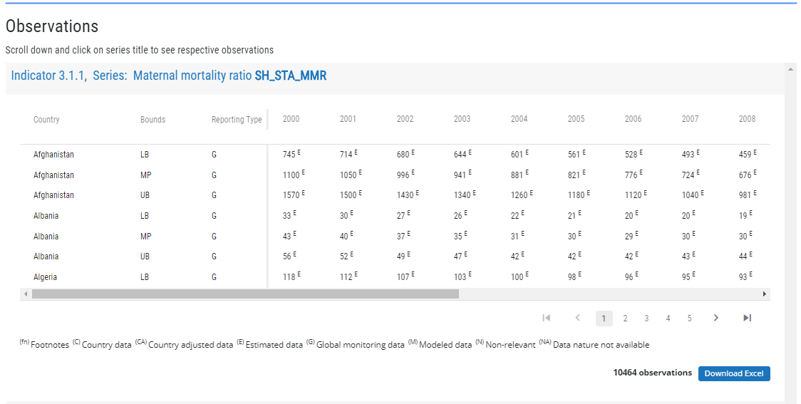
Why is user-producer dialogue important?
Upgrade the NSS coordination mechanism
U-P Dialogue
Non-coordinated NSS
Well coordinated NSS
(a) Find the right data
(b) Find misleading data
Potential data user
Data producer
Data producer
INSTITUTIONALIZED DIALOGUE / CREATION OF WORKING GROUPS
(c) Not find the data (although it exists)
Potential data user
CENTRALIZED DATA REPOSITORY
On-line search
(d) Data does not exist

Slide 10
4
User-producer dialogue: step-by-step

Slide 11
User-producer dialogue: step-by-step
U-P dialogue often includes the following steps:
Stakeholder mapping
- Gov officials, policy-makers, programme managers
- Researchers / academicians
- CSOs , international org, media, private sector, ordinary citizens
- Statisticians
Communication
- Producers communicate what they offer
- Users communicate what they need for policy-making, etc.
- Further conversations to assess constraints & bridge gaps
Collaborative agreements
- Governance and operational arrangements
- Coordinate production of gender statistics
- Coordinate on analysis, dissemination & use of gender statistics

Slide 12
User-producer dialogue: step-by-step
Stakeholder mapping
Users and producers should be fully engaged
Map all relevant stakeholders before U-P dialogue
Data producers
Representatives from NSOs
Representatives from Line Ministries (education, labor, health, etc.)
Civil registrars
Representatives from national security institutions
Data users
Policy makers
Parliamentarians who want to make evidence-based decisions
Civil society institutions
Labor unions who might need gender data for advocacy purpose
Academicians and Researchers
Think-tanks
Private sector entities using data for business processes or CSR
Preferable if Users and Producers have decision-making power!

Slide 13
User-producer dialogue: step-by-step
Communication
Communication is at the core of user-producer dialogue
Users communicate their needs, from a thematic and technical perspective
Producers communicate their capacity and limitations to respond to users’ needs
Share information about calendars of releases, available data, data sources
Share concerns about statistical literacy and points of contact
Discuss the need and scope for a formal mechanism for long term User-Producer engagement
Dialogue can be organized alongside workshops and conferences
Dialogue can be institutionalized (e.g. technical committees, focus groups)

Slide 14
User-producer dialogue: Communication
User-Producer Dialogue: Maldives Case , 2019
Communication exercise between users and producers
On-line survey completed prior to the dialogue
Users and producers rated indicators based on data availability, data needs and data use in their respective jobs
Key Findings
Users are more aware of data for the more “traditional” indicators
Clear need for data on some areas (e.g. environment, health) from a gender perspective
There is some misinformation (e.g. some data is believed to exist when it doesn’t)
Key Solutions
Need to centralize gender data into single data repository and enact national statistics law
Need to institutionalize user-producer dialogues
Need for better data communication strategies
Urgent localization of SDG indicators to prioritize gender data production
Need to organize data user trainings

Slide 15
User-producer dialogue: step-by-step
Collaborative agreements
Dialogues might result in the establishment of coordination groups
This can ensure dialogues take place more regularly
To overcome the costs, dialogues can be held on-line
Resources must be allocated to user-producer conversations
Financial resources
Human resources

Slide 16
User-producer dialogue: Collaborative agreements
Example of outcomes from dialogue for Gender Data Production:
Assess the existing scenario on data availability and use
Assess the adequacy of the Statistical Act
Assess the effectiveness of gender data production process
Establish mechanisms to carry out revisions
Documents results of dialogue, discuss next steps, identify key actors and reporting mechanisms
Example of outcomes from dialogue for Gender Data Analysis, Dissemination and Use:
Reveal the need for better data communication strategies and products
Identify which data should be disseminated
Identify target audiences and their skills/needs
Identify need for training
Establish joint training initiatives)
E.g. data producers train journalists on statistical literacy ; journalists train data producers on effective communication

Slide 17
Organizing a gender statistics user-producer dialogue : an example
5

Slide 18
Organizing gender statistics user-producer dialogue: an example
MEET UP
Call a meeting among NSO, Ministry of Women, relevant ministries that produce or use gender data, UN Women Country office, Civil Society Organizations, Journalists and any researchers that might be interested on the topic -- identify the needs and level of skills of each of these stakeholders.
Discuss pressing issues/outputs needed for a gender picture (e.g. a publication, priority indicators, etc.)
REVIEW
Review existing statistical activity in connection to gender data and how well it meets user's needs
Identify information needs and gaps to deliver on these commitments and on related user's requests
MEET AGAIN
Discuss the results from the review and identify potential solutions
Two-way communication on how to address the gaps, what is most useful and what is possible
Review commitments (statistical act, policy priorities, national development strategiey, gneder equality strategy, National SDG roadmap, commitments to report)
Document the results of the review process

Slide 19
Organizing gender statistics user-producer dialogue: an example
DEBRIEF
Identify immediate next steps based on the dialogue, including responsible parties and resource needs
REPORTING
Produce a report capturing the main conclusions from the discussion
MEET AGAIN
Ensure the two-way communication continues periodically in the future
Discuss strategies towards institutionalizing systematic dialogue between users and producers
NSO, Ministry of Women and UN Women Country Office meet again (all other actors may also be invited based on needs)
Feature next steps prominently, which must include reporting processes for each of the responsible parties
Share the report with all actors involved for comments and uptake
Future meetings could include time for reporting of progress to assess whether objectives are being met
Re-evaluate in case of changing needs

Slide 20
6
Potential drawbacks of user-producer dialogue

Slide 21
Potential drawbacks of user-producer dialogue
Timetable for data production, analysis, releases and communications might be lengthened
Conflicting opinions might exist
It might yield competing demands
Might raise unrealistic expectations about producer’s capacity to fulfill data needs
Might raise unrealistic expectations about user’s capacity to find, interpret and use data
Dialogue might lead to disappointment when expectations are not met

Slide 22
7
Key Takeaways

Slide 23
Key Takeaways
Users and producers should both be active players in an effective dialogue.
To start a user-producer dialogue, a topic should be selected, all potential stakeholders should be identified and a preliminary assessment of needs and limitations should be carried out.
Consultations can begin in advance to assess the needs and demands of each of the stakeholders.
Conversations should revolve about identifying solutions for such needs and challenges, although it is important to keep expectations realistic and pace the discussions.
It is important that the results of the user-producer dialogue are recorded, and arrangements are made to ensure continuity of the dialogue and resolution of challenges in the long term.
Ensure financial and human resources are allocated as needed for continuity of the conversations and implementation of the results.
Collaborative agreements should be put in place to ensure (1) the continuity of the dialogue, (2) enhanced and better targeted data production, and (3) improved data dissemination strategies.
Training should be one of the key outcomes of the dialogue. While statisticians might consider organizing trainings on how to find, analyze and interpret gender data, want to train statisticians on how to communicate gender data more effectively.

Slide 24
Thank You

