Slide 1
User-Producer Dialogue
ASIA-PACIFIC TRAINING CURRICULUM ON GENDER STATISTICS

Slide 2
Become familiar with the concepts of data users, data producers and statistical production processes
Understand the importance of aligning the needs of users with the supply of gender data
Learn about the tools to establish effective dialogues
1
Learning Objectives

Slide 3
2
What is usually referred to as user-producer dialogue?

Slide 4



What is usually referred to as user-producer dialogue?
Data producers
Organizations in charge of generating data
In the context of SDG monitoring for gender data, these can include:
    National Statistical Offices (NSO)
    Line ministries
    Other government departments
    And rarely: Private sector, CSOs and International Organizations
Data users
Any consumers of data
Most common data users include:
    Policy makers
    Other decision makers
    Government bodies
    Civil Society Organizations
    Academicians and researchers
    Private sector institutions
    International organizations
Drawing the line can be tricky sometimes

Slide 5
3
Why is user-producer dialogue important?

Slide 6
Why is user-producer dialogue important?
User-producer dialogue enhances gender data use → Impacts the lives of women and girls
1. Official statistics meet user's needs
2. Trust
3. Enhanced data quality
4. Users able to find and understand the data
5. Upgrade of the NSS coordination mechanisms
INCREASED DATA USE

Slide 7
Why is user-producer dialogue important?
1. Align the production of official statistics with user’s needs
Consultations can create opportunities to generate targeted gender data
Data can be better suited to potential user’s needs → increased data use
Dialogue is relevant at 2 levels: Thematic and Format-based
Dialogue to address thematic needs
Policy priorities change over time
Hence data needs change
Dialogue can better align work programmes and priorities
Dialogue to address format-based needs
Ensures tailoring data production with user expertise
Allows to feed information to users through their desired channels

Slide 8
Why is user-producer dialogue important?
2. Builds trust
Users can better appreciate good quality gender data
Users can learn to differentiate accurate from misleading statistics
Producers can trust users on their use of microdata / sensitive data
3. Enhanced data quality
Enhance quality of statistics as policy experts can help identify inconsistencies, discrepancies and issues with data
4. Users able to find and understand the data
Producers can enhance user’s statistical literacy
Users can learn where to find the right gender data
Users are better equipped to interpret the data correctly

Slide 9









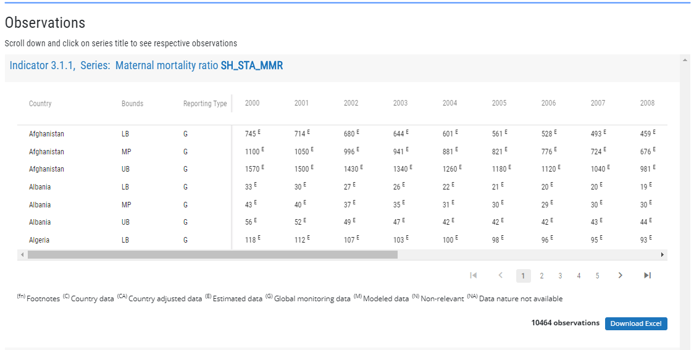


Why is user-producer dialogue important?
Upgrade the NSS coordination mechanism
U-P Dialogue
Non-coordinated NSS
Well coordinated NSS
(a) Find the right data
(b) Find misleading data
Potential data user
Data producer
Data producer
INSTITUTIONALIZED DIALOGUE / CREATION OF WORKING GROUPS
(c) Not find the data (although it exists)
Potential data user
CENTRALIZED DATA REPOSITORY
On-line search
(d) Data does not exist

Slide 10
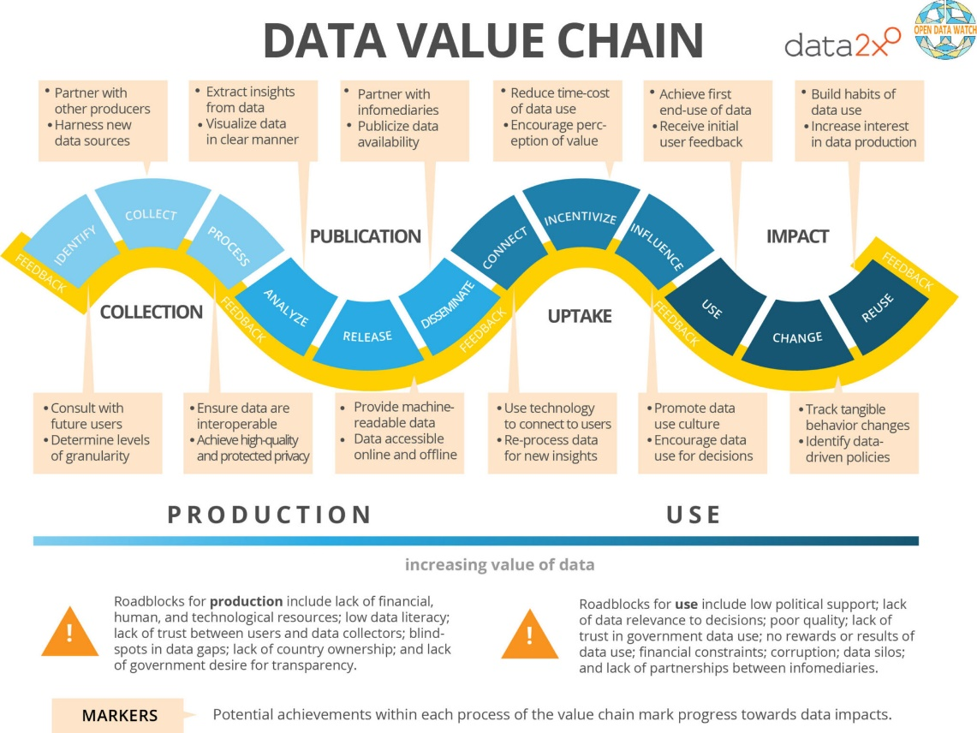
Data Value Chain
Describes the full data lifecycle from collection to analysis and usage
Categorizes steps to transform raw data into useful insights
Essential for understanding the process of turning data into meaningful information

Slide 11
Data Value Chain: Collection
First Phase: Identification
  Data producers determine what data to collect and how users will utilize them.
  Critical decisions influencing data quality and usability are made during this stage.
Subsequent Phase: Process Establishment
  Establishing a process for data collection, involving surveys, administrative data retrieval, or remote sensing methods.
  Decisions in this phase impact data quality and usability throughout their entire life cycle.
Final Phase: Data Processing
  Processing data to ensure accurate recording, classification, and storage in usable formats.
  Adhering to international standards and frameworks enhances data quality and user trust.
  Signifies the initial growth of data value.

Slide 12
Data Value Chain: Publication
Initial phrase: Analysis for Useful Insights
  Data analysis to derive meaningful insights.
  Visualize data in a manner that users understand and fits their needs.
  Increases data value as they progress through the publication stage.
Subsequent phrase: Publishing with Proper Documentation
  Data, accompanied by metadata, are published in both online and offline formats.
  Ensures proper documentation for user understanding.
Final phrase: Dissemination to Potential Users
  Dissemination of data to reach potential users.
  Critical for expanding data accessibility.

Slide 13
Data Value Chain: Uptake
Initial phrase: Connecting Data with Users
  Establishing connections between data and users.
  Utilizing channels like press releases and online dissemination.
2nd phrase: Motivating Integration into Decision-Making
  Motivating users to integrate data into decision-making processes.
  Various incentives, including government orders and budget allocations, contribute to enhancing data value.
3rd phrase: Influencing Recognition of Data Value
  Advocates fostering a culture that values evidence-based policies.
  Training initiatives and operational mandates play a role in incentivizing data use.

Slide 14
Data Value Chain: Impact
Initial phrase: Using Data for Understanding
  Utilizing data to understand problems or make informed decisions.
  Ranging from quick decisions to more extended analysis processes.
2nd phrase: Changing Project Outcomes
  Changing outcomes of projects or improving situations based on data insights.
  Encouraging positive changes resulting from data use.
3rd phrase: Reusing Data
  Reusing data by combining and freely sharing them.
  Fostering a culture of data reuse for continuous impact.

Slide 15
4
User-producer dialogue: step-by-step

Slide 16
User-producer dialogue: step-by-step
U-P dialogue often includes the following steps:
Stakeholder mapping
- Gov officials, policy-makers, programme managers
- Researchers / academicians
- CSOs , international org, media, private sector, ordinary citizens
- Statisticians
Communication
- Producers communicate what they offer
- Users communicate what they need for policy-making, etc.
- Further conversations to assess constraints & bridge gaps
Collaborative agreements
- Governance and operational arrangements
- Coordinate production of gender statistics
- Coordinate on analysis, dissemination & use of gender statistics

Slide 17
User-producer dialogue: step-by-step
Stakeholder mapping
Users and producers should be fully engaged
Map all relevant stakeholders before U-P dialogue
Data producers
Representatives from NSOs
Representatives from Line Ministries (education, labor, health, etc.)
Civil registrars
Representatives from national security institutions
Data users
Policy makers
Parliamentarians who want to make evidence-based decisions
Civil society institutions
Labor unions who might need gender data for advocacy purpose
Academicians and Researchers
Think-tanks
Private sector entities using data for business processes or CSR
Preferable if Users and Producers have decision-making power!

Slide 18
User-producer dialogue: step-by-step
Communication
Communication is at the core of user-producer dialogue
Users communicate their needs, from a thematic and technical perspective
Producers communicate their capacity and limitations to respond to users’ needs
Share information about calendars of releases, available data, data sources
Share concerns about statistical literacy and points of contact
Discuss the need and scope for a formal mechanism for long term User-Producer engagement
Dialogue can be organized alongside workshops and conferences
Dialogue can be institutionalized (e.g. technical committees, focus groups)

Slide 19
User-producer dialogue: Communication
User-Producer Dialogue: Maldives Case , 2019
Communication exercise between users and producers
  On-line survey completed prior to the dialogue
  Users and producers rated indicators based on data availability, data needs and data use in their respective jobs
Key Findings
  Users are more aware of data for the more “traditional” indicators
  Clear need for data on some areas (e.g. environment, health) from a gender perspective
  There is some misinformation (e.g. some data is believed to exist when it doesn’t)
Key Solutions
  Need to centralize gender data into single data repository and enact national statistics law
  Need to institutionalize user-producer dialogues
  Need for better data communication strategies
  Urgent localization of SDG indicators to prioritize gender data production
  Need to organize data user trainings

Slide 20
User-producer dialogue: step-by-step
Collaborative agreements
Dialogues might result in the establishment of coordination groups
This can ensure dialogues take place more regularly
To overcome the costs, dialogues can be held on-line
Resources must be allocated to user-producer conversations
  Financial resources
  Human resources

Slide 21
User-producer dialogue: Collaborative agreements
Example of outcomes from dialogue for Gender Data Production:
  Assess the existing scenario on data availability and use
  Assess the adequacy of the Statistical Act
  Assess the effectiveness of gender data production process
  Establish mechanisms to carry out revisions
  Documents results of dialogue, discuss next steps, identify key actors and reporting mechanisms
Example of outcomes from dialogue for Gender Data Analysis, Dissemination and Use:
  Reveal the need for better data communication strategies and products
  Identify which data should be disseminated
  Identify target audiences and their skills/needs
  Identify need for training
  Establish joint training initiatives)
  E.g. data producers train journalists on statistical literacy ; journalists train data producers on effective communication

Slide 22
Organizing a gender statistics user-producer dialogue : an example
5

Slide 23
Organizing gender statistics user-producer dialogue: an example
MEET UP
Call a meeting among NSO, Ministry of Women, relevant ministries that produce or use gender data, UN Women Country office, Civil Society Organizations, Journalists and any researchers that might be interested on the topic -- identify the needs and level of skills of each of these stakeholders.
Discuss pressing issues/outputs needed for a gender picture (e.g. a publication, priority indicators, etc.)
REVIEW
Review existing statistical activity in connection to gender data and how well it meets user's needs
Identify information needs and gaps to deliver on these commitments and on related user's requests
MEET AGAIN
Discuss the results from the review and identify potential solutions
Two-way communication on how to address the gaps, what is most useful and what is possible
Review commitments (statistical act, policy priorities, national development strategiey, gneder equality strategy, National SDG roadmap, commitments to report)
Document the results of the review process

Slide 24
Organizing gender statistics user-producer dialogue: an example
DEBRIEF
Identify immediate next steps based on the dialogue, including responsible parties and resource needs
REPORTING
Produce a report capturing the main conclusions from the discussion
MEET AGAIN
Ensure the two-way communication continues periodically in the future
Discuss strategies towards institutionalizing systematic dialogue between users and producers
NSO, Ministry of Women and UN Women Country Office meet again (all other actors may also be invited based on needs)
Feature next steps prominently, which must include reporting processes for each of the responsible parties
Share the report with all actors involved for comments and uptake
Future meetings could include time for reporting of progress to assess whether objectives are being met
Re-evaluate in case of changing needs

Slide 25
6
Potential drawbacks of user-producer dialogue

Slide 26
Potential drawbacks of user-producer dialogue
Timetable for data production, analysis, releases and communications might be lengthened
Conflicting opinions might exist
It might yield competing demands
Might raise unrealistic expectations about producer’s capacity to fulfill data needs
Might raise unrealistic expectations about user’s capacity to find, interpret and use data
Dialogue might lead to disappointment when expectations are not met

Slide 27
7
Key Takeaways

Slide 28
Key Takeaways
Users and producers should both be active players in an effective dialogue.
To start a user-producer dialogue, a topic should be selected, all potential stakeholders should be identified and a preliminary assessment of needs and limitations should be carried out.
Consultations can begin in advance to assess the needs and demands of each of the stakeholders.
Conversations should revolve about identifying solutions for such needs and challenges, although it is important to keep expectations realistic and pace the discussions.
It is important that the results of the user-producer dialogue are recorded, and arrangements are made to ensure continuity of the dialogue and resolution of challenges in the long term.
Ensure financial and human resources are allocated as needed for continuity of the conversations and implementation of the results.
Collaborative agreements should be put in place to ensure (1) the continuity of the dialogue, (2) enhanced and better targeted data production, and (3) improved data dissemination strategies.
Training should be one of the key outcomes of the dialogue. While statisticians might consider organizing trainings on how to find, analyze and interpret gender data, want to train statisticians on how to communicate gender data more effectively.

Slide 29
Thank You

