Slide 1
Gender data literacy and avoiding common mistakes
ASIA-PACIFIC TRAINING CURRICULUM ON GENDER STATISTICS

Slide 2
Become familiar with basic data concepts and ensure that the correct meaning, or semantics, of statistics are understood.
Gain knowledge on specific issues of gender data such as time use, violence and crime data, etc.
- Understand the issue of misinterpretation of data and how to avoid it.
1
Learning Objectives

Slide 3
Understanding definitions and key concepts in the area of gender statistics
2

Slide 4
Official vs. Non-Official Statistics
Official Statistics
Produced by either the National Statistics Office or another government body in charge of data production (e.g. line ministries, National Meteorology Agency, etc.)
Produced in accordance with the National Statistics Law/Act and in line with the Fundamental Principles of Official Statistics
Produced by a third-party organization but cleared by the National Statistical Authority (e.g. National Statistical Office, Statistical Capacity-Building Trust)
Some examples: Figures derived from Census data, official surveys, administrative records
Non-Official Statistics
Produced by third-party organizations without the involvement of national statisticians
Often narrower in coverage (especially regarding sample sizes)
- Usually ad-hoc studies and one-off data collection experiments

Slide 5
Official vs. Non-Official Statistics
What else should I know about official statistics?
Official statistics include:
- Figures derived from Census data (e.g. population count)
- Estimates derived from surveys (e.g. Labour force Survey that gives information on employment and unemployment rates)
- Aggregates calculated using administrative records (e.g. birth registration)
- In some countries, the government might derive official statistics from non-conventional
sources (e.g. big data, crowdsourcing, etc.)
Are these official statistics?
Unemployment rate for January 2019, by sex
Proportion of patients whose symptoms improved faster than the placebo group in a clinical trial

Slide 6
Metadata
Metadata is the information about data
It refers to a range of information, such as:
Context in which statistical information was collected, processed and analyzed
Information about methods
Key concepts
Nomenclatures
Sample and coverage
2 types of metadata are:
Indicator metadata
Data point metadata

Slide 7
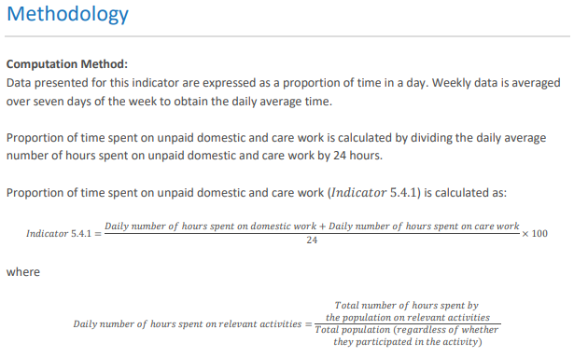
Indicator metadata: What is it and where to find it?
- What does it include?
Official indicator name
Definitions
Rationale
Methods of computation / Formulas
Information about exceptions, methodological concerns and limitations
Information about usual data sources utilized to derive the indicator
If the metadata refers to an SDG indicator, it often also includes information about custodian agencies and methodology for the production of regional aggregates.
- Where to find it?
On-line repositories (e.g. https://unstats.un.org/sdgs/metadata/)
Example: Metadata for Indicator 5.4.1

Slide 8
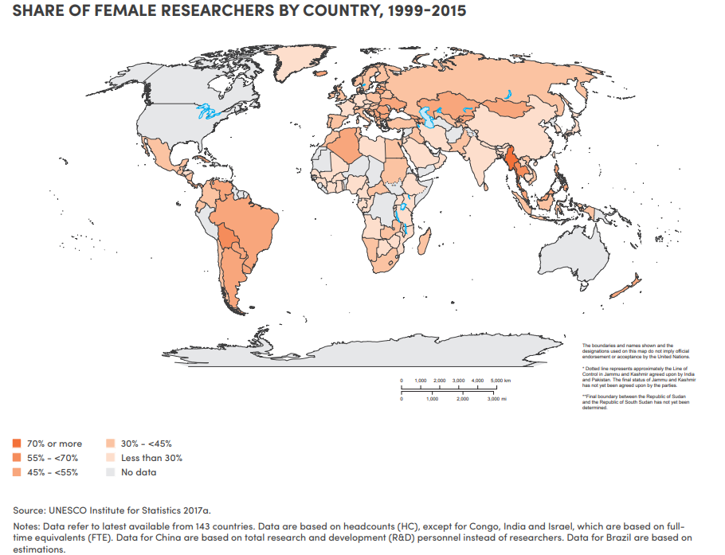
Data point metadata: What is it and where to find it?
- What does it include?
Information about specific datapoints
Explanation about exceptions
Information about coverage
Methodological limitations
Specific details about one particular data point
-Where to find it?
In the form of footnotes
Alongside data tables or in data cells
In survey reports
Example: Data point metadata is often found in the form of footnotes, alongside data tables or in data cells. Here is an excerpt of the data point metadata for the share of female researchers, by country, for the years 1999–2015

Slide 9
Why is metadata important?
Metadata makes data meaningful
Without metadata, you would not understand data.
Do you know what this data is about?

Slide 10
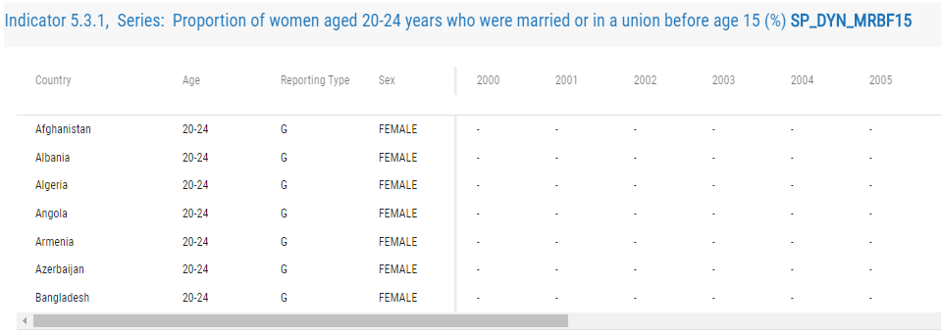
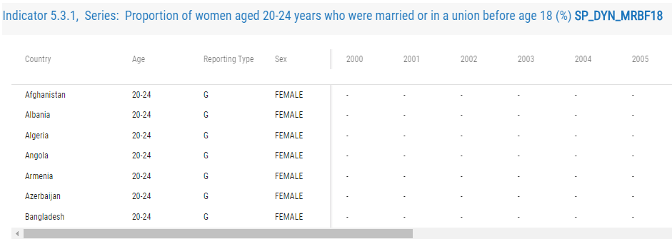
Why is metadata important?
Metadata improves comparability of data:
Concepts can have different definitions, units and classifications.
To avoid discrepancies and misinterpretations, always look at the metadata
Example: Both these tables have estimates for child marriage

Slide 11
Why is metadata important?
Metadata provides information about inconsistencies in computation methods
E.g. 3 different ways of computing estimates for Adolescent Birth Rates
Same definition, different methods of computation
Depends on the source of data
Civil registration data
The numerator is the registered number of live births by women aged 15-19 in a given year, and the denominator is the estimated or enumerated population of women aged 15-19 years.
Survey data
The numerator is the number of live births obtained from retrospective birth histories of the interviewed women who were 15-19 years of age at the time of the births during a reference period before the interview. The denominator is person-years lived between the ages of 15-19 years by the interviewed women during the same reference period.
Census data
The adolescent birth rate is computed on the basis of the date of last birth or the number of births in the 12 months preceding the enumeration. The census provides both the numerator and the denominator for the rates.

Slide 12
International definitions
Internationally agreed definitions exist for almost all statistical concepts
Ensure international comparability of data
For SDG indicators, they can be found in the SDG metadata repository
Example: When calculating proportion of urban population living in slums, you are looking at population deprived in at least one of the following areas:
Improved water source
Improved sanitation facilities
Sufficient living area
Durable materials
Security of tenure
Each of these 5 areas have their own definitions.
- Understanding the metadata is essential to interpret the data

Slide 13
Data
Data is information about measurements or observations
2 types of data: Macrodata and Microdata
Macrodata
National aggregates
Choose macrodata when looking at national-level estimates
Choose macrodata when looking for readily available estimates. Representative of a country or select group within the country
Microdata
- Individual-level data
- Data collected from each individual through a survey or interview
- Choose microdata when your country has conducted a relevant survey to your area of interest but has not produced exactly the estimate you are looking for
- Choose microdata when you want to conduct further testing, including association between variables

Slide 14
Variable
An element or factor than can vary or change
Any element capable of having multiple values
Also called data item when working with survey data
Some examples:
Age
Sex
Marital status
Age at death
Age at first pregnancy
No. of children
No. of people in house
Height is a variable because it can vary from person to person.

Slide 15
Avoiding common mistakes when interpreting data: Understanding the semantics
3

Slide 16
Difference between Ratio, Rate, Proportion, Percentage and Percentage points
3.1

Slide 17
Ratio
A ratio compares the frequency of one value for a variable with another value for the same variable
For example, if a coin is tossed 20 times,
Heads turns up 12 times
Tails turns up 8 times
Among development indicators, for example:
Sex ratio at birth represents the number of births per 100 female births.
In this context, we are examining two possible outcomes (boy or girl) within the same variable (live birth)
So, if sex ratio of 105 means that per 100 female births, there are 105 male births
Ratio is 12:8 (spoken as 12 to 8)

Slide 18
Rate
Rate is a measurement of one value for a variable in relation to another measured quantity
Example: Adolescent birth rate
It is defined as the number of births delivered by women aged 15-19 years per 1,000 women in that age group
2 different variables are being considered in the numerator and denominator

Slide 19
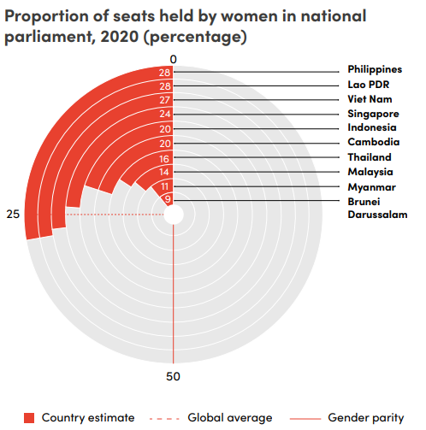
Proportion
Number of times a particular value for a variable has been observed, divided by the total number of values in the population
The numerator is included in the denominator, hence representing parts of a whole or shares
It is always between 0 and 1, and can be expressed as a percentage when you multiply it by 100
Proportions are one of the most statistically used concepts in development indicators
For example:
The proportion of seats held by women in national parliaments is calculated by dividing the number of seats held by women by the total number of seats in the national parliament

Slide 20
Percentage
A percentage is the expression of a value for a variable in relation to a whole population as a fraction of one hundred
Proportions are often expressed as percentages
For example, “Proportion of time spent on unpaid care and domestic work” can be expressed as:
Someone spends 3 out of 12 hours on unpaid care and domestic work
25% of their time is spent on unpaid care and domestic work (value expressed out of 100)
3 out of 12 hours spent on unpaid work (proportion)
25 % of the time spent on unpaid work

Slide 21
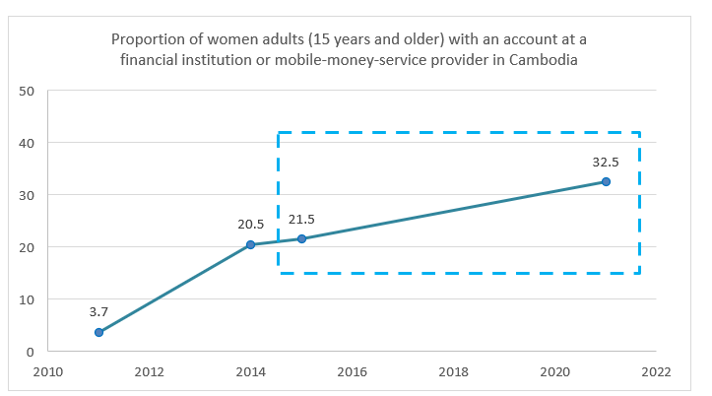
Percentage points
Percentage points are used to express increments, drops or differences
Percentage points often represent decimal points
Percentage and percentage point are NOT the same
Percentage Points Change
To calculate the change in percentage points, simply subtract the value for the later year from the value of the former year. In this case, this will be:
32.5− 21.5 = +11
Here, +11 simply means that there has been an increase. If it was -11, it would mean a drop.
Percentage Change
To calculate change in percentage, divide the difference in percentage points by the initial value. This is to see how much change has taken place with respect to the starting point. In this case, since the starting point was 2015, the denominator will be 21.5 and the complete formula will be:
vs

Slide 22
3.2
Difference between Mean, Median, Average and Total

Slide 23
Mean
Mean is the sum of all the values in a data set, divided by the total number of values
It is the most commonly used measure of central tendency
It measures the prominent behavior of data when data is a normal distribution
For example:
$$2,3,5,6,20$$
- Mean is calculated by adding all the values and dividing by the total number of values, as shown below:
$$Mean= \frac{Sum of all observations}{Total number of observations}$$
$$Mean= \frac{2+3+5+6+20}{5}=7.2$$
The mean is a good measure for normal distributions, but it is not a robust measure, meaning it is influenced by outliers.
For instance, in a distribution such as [1,1,1,1,1,1,1,1,1,1,1,1,1000] The mean is 77.8 - although the majority of the values are actually 1.

Slide 24
Median
Median is the numeric value separating the higher half of a sample, a population, or a probability distribution, from the lower half
In practice, it is computed by arranging the numbers in ascending order and locating the middle number in the centre of that distribution
It is also a measure of central tendency and is not influenced by outliers
$$2,3, 5, 6, 20$$
HOW TO CHOOSE THE MEDIAN?
If your distribution has an even number of observations, the mean would be the sum of the two middle numbers, divided by 2
If your distribution has an odd number of observations, choose the number that falls in the middle

Slide 25
Average and Total
Average:
Statisticians don’t really use the word average
The more precise terms are mean or median
Total:
The total value is a whole number or amount
For instance, 730 million people lived below the poverty line in 2015.
Maintain caution when using Total values for comparison
If we only say “200,000 more people are now living in poverty”, it appears as a negative development
Due to overall population increase, it is possible that the actual poverty rates have dropped over time

Slide 26
Minimum, Maximum and Range
Minimum: lowest value in the dataset
Maximum: largest value in the dataset
Range: the difference between the maximum and minimum (Maximum value – Minimum value)
Range can be misleading when we have outliners in the dataset
Do not interpret range if there is only a single set of data
Example:
Lowest monthly household income = $5000
Highest monthly household income = $15000
Range= $15000 - $5000 = $10000
(* Since we only have one set of observations, thus, we simply say: the monthly income range of households is from $5000 to $15000)

Slide 27
3.3
Misinterpretation issues specific to gender data

Slide 28
Interviewing only the household head to obtain data
Data disaggregation by sex of household head can never replace sex-disaggregated data
Why?
Males might not have accurate information about women
Biased information about violence against women, control issues, etc.
Fails to capture intra-household inequalities
Bias regarding household composition (e.g. most women-headed households are single adult households; most male-headed households are not)
Questions about women must be asked to women
Graphic credit: Delwar Hossain

Slide 29
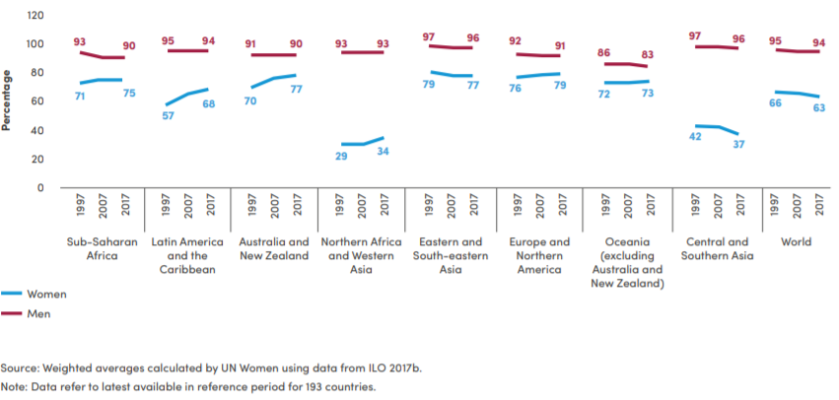
Measuring gender gaps
Measuring gaps is important to provide a picture of equality
The trend of gaps may differ from the overall trend of an indicator
For example, observe the data for women and men in the Oceania
Labour force participation rate among population aged 25-54 by sex and region, 1997-2017
- Hence, there is a need to look at individual indicator values for women and men, and not just the gap

Slide 30
Violence and crime data
Violence and crime estimates are ALWAYS UNDERREPORTED
Most victims do not report instances to the police because:
Victims fear for their own safety
Victims believe reporting won’t lead to results
Stigma associated with violence
Surveys are a better instrument to capture this data because:
Victims are more likely to disclose incidents when asked (as opposed to going to the police)
Enumerators are specifically trained to build rapport with victims
Trained enumerators are more sensitive to confidentiality issues
Enumerators are aware of the psychological harm while recalling violent instances
Women are interviewed separately
Question order and wording are carefully crafted in specialized surveys
Graphic credit: Siwat V.

Slide 31
Time Use Data
Quantitative summaries of how individuals “spend” their time (over 24h or 7 days)
Key issues when interpreting time-use data are:
Information collected over different days (weekdays vs. weekends) and over different seasons
Refer to ICATUS to understand classification of activities
Unpaid care and domestic work only includes work for own-use and in the form of services
Time-use information is best measured using diaries:
Capture simultaneous activities
Activity categories | 04:00-05:00 |  |  |  | 05:00-06:00 |  |  |  | 06:00-07:00 |  |  |  | 07:00-08:00
Sleeping
Eating
Personal care
School
Work as employed
Own business work
Framing
Animal-rearing
Fishing
Shopping
Weaving, sewing
Cooking
Domestic work
Care for children
Commuting

Slide 32
Sex disaggregated poverty rates
Poverty rates are typically calculated at the household level and:
Fail to capture intra-household inequalities
To capture accurate measures of individual allocation of resources, separate assessments of income and/or expenditure at the individual level are necessary
Check indicator metadata to assess whether the data pertains to household-level or individual-level estimates
Image credit: Flaticon

Slide 33
Gender pay gap
Mean hourly earnings from paid employment by sex
Pay by occupation and level and taking into consideration total time worked
Interpreting this indicator:
Pay gap DOES NOT JUST reflect the average pay of women vs. the average pay of men in a certain country
Compares earnings for a certain occupation and level
Gross remuneration in cash or in-kind for time worked or work done, (includes remuneration for annual vacation, other type of paid leave)
Excludes employers’ contributions to social security, pension and related benefits
Excludes severance and termination pay.
Image credit: Flaticon

Slide 34
Gender pay gap
Unadjusted pay gap
Measured as the difference between the average hourly earnings of women and men, divided by the mean hourly earnings of men
Does not take into account the portion of the gender pay gap attributed to discrimination and the portion resulting from various factors such as education, work experience, etc
Straight forward comparison of average earnings between men and women
Adjusted pay gap
Calculated using complex formula using different statistical methods, such as regression analysis
Takes into account various factors to provide a more accurate understanding of the pay disparity that can be attributed to gender discrimination
A more nuanced view and helps to identify areas where gender-based pay disparities exist even after accounting for other relevant variables

Slide 35
4
Key takeaways

Slide 36
Key takeaways
Always refer to metadata and international definitions when interpreting data
Percentage is different from percentage points
Rate is different from ratio
Mean is different from median, although both are measures of central tendency
Median is a better measure of central tendency when a distribution is skewed because it does not get affected by extreme value
Household head is not a good substitute for sex-disaggregated data
Violence statistics are always underreported
Time-use statistics are more accurate when compiled using time diaries, because they capture simultaneity
Poverty rates are difficult to calculate at the individual level. If applying household composition to perform sex disaggregation, the estimates will fail to capture intra-household inequalities
Gender pay gaps attempt to capture whether men and women receive equal pay for equal work

Slide 37
Thank You

