Slide 1
Module 10:
Communicating gender data
Training on the revised syllabus
5 August 2024

Slide 2
CURRENT TABLE OF CONTENTS
Communicating gender data
Common channels for communicating gender data and how to use them effectively
Visual communication of data
Key takeaways
Notes:
Chapter 2 includes databases, reports, fact sheets, media, articles, data viz for stories, social media, data journalism
Chapter 3 is on visualization, as well as typography, pictograms, infographics

Slide 3
WHAT’S MISSING IN THE CURRENT MODULE?
Seems aimed more towards producers
Structure and organizational logic needs rethinking
Data visualization content woven through but also in a dedicated section
Too long!
Content needs updating
Data journalism and other key issues not fleshed out
Notes:
Chapter 2 includes databases, reports, fact sheets, media, articles, data viz for stories, social media, data journalism
Chapter 3 is on visualization, as well as typography, pictograms, infographics

Slide 4
NEW PROPOSED STRUCTURE
01
COMMUNICATING GENDER DATA
CONCEPTS
02
COMMUNICATION STRATEGIES
03
ETHICS
Green marketing is a practice whereby
04
WHERE TO FIND GENDER DATA
TABLE OF CONTENTS
TECHNIQUES
Green marketing is a practice whereby
05
HOW TO VISUALIZE DATA
06
SOCIAL MEDIA
PRACTICE
07
STORYTELLING (DATA JOURNALISM)
08
CASE STUDY
Notes:
Clustered content into three areas: concepts, techniques and then data use. Here – 2 chapters are wild cards and in the discussion we can see where they might be best placed. Ethics and the case study.
I put ethics into concepts because it is related to key concepts around communicating gender data, but does it belong under using data?
I put the case study under data use because the case study should highlight examples of how users communicate using data
Why did I use this structure?
First it seemed obvious to lead with the key issues around communicating gender data, this is similar to the original.
Then I wanted to talk about data sources and what to use the data once you get it from these sources. Again, I’m using the title from a user’s perspective but am open to changing it so it feels relevant and intuitive to both users and producers.
Finally, I wanted to highlight how to apply what we’ve learned in different contexts, particularly in social media (this was raised in the previous meeting) and data journalism, also previously seen as a gap.
To cap it all off, I wanted to have a few case studies that highlight successful examples of communicating gender data. I’ve put it in using data, but I think it would also be useful to have cases on producers. Also for discussion.

Slide 5
CONCEPTS
01
COMMUNICATING GENDER DATA

Slide 6
KEY CONCEPTS
1.1. Why should we communicate data?
    Introduce the concept of dissemination
    Data waste
1.2 The difference between dissemination and communication
    Box on data users vs. producers
1.3. Why are gender data necessary?
    Principles of data feminism
1.4. The data production/communication cycle
    The role of data users and producers in the cycle
    Case studies
    Box on missing data

Slide 7
1.4 DATA PRODUCTION/COMMUNICATION CYCLE
Data analysis in coordination with users (to meet their needs)
Generation of reports, infographics, media products, web materials, etc. in line with user's needs.
PRODUCT
DEVELOPMENT
ANALYSIS
PRODUCERS
Communication of findings and dissemination of products using targeted channels for each user
Dialogue between users and producers to identify data needs and desired formats
COMMUNI-
CATION &
USE
DEVELOPMENT
USER ENTRY POINTS SHOWN IN EACH PART OF THE CYCLE
DESIGN
Dialogue between users and producers to identify data needs and desired formats
Notes:
If you are producing any statistical products the data and production cycle will be important. It is also important from a communications perspective because if uptake and use of statistics is to be increased stakeholders/users/producers dialogues need to take place at each stage of the production.
The dialogue between users and producers can be used to inform the formats, analysis and product development.
Use your product development phase to its maximum capacity to identify target audiences, develop communication plans and communicate your findings and use.
It is very important to engage users at each stage of the production cycle to improve appropriateness and ensure uptake and use.

Slide 8


ENGAGING USERS – A TWO-WAY STREET
Pre-production dialogue
Post-production dialogue
Notes:
Note: users are not monolithic and there are different levels of data literacy among users

Slide 9
CONCEPTS
02
COMMUNICATION STRATEGY

Slide 10
KEY CONCEPTS
2.1. Characteristics of a communication strategy
2.2. Turning a communication strategy into an action plan
2.3. Media monitoring

Slide 11







CHARACTERISTICS OF A COMMUNICATION STRATEGY
CONTINUED ENGAGEMENT
PRIORITIES
The earlier stakeholders and target audiences become involved in the data production process, the higher adoption and use will be.
Define clear communication goals and priorities
ADVOCACY
THEORY OF CHANGE
Advocacy should guide the activities
What is the change you are seeking, and how do you plan to get there?
TARGETED ACTIVITIES
TARGET AUDIENCE
Specific strategies developed: Separate activities for different target audiences
Who do you want to reach? Who are the stakeholders?
DIVERSE CHANNELS
KEY MESSAGES
How are you going to reach the target audiences?
Create a set of key messages
YOUR TITLE 02
Notes:
A communication and outreach strategy is important for any activity dealing with an audience or user of your data and statistics communication materials.
It is a living document and is dynamic, your priorities and audiences may keep changing. You will continue to come back to it, revisit and refine it.
You must have a clear sense of the goals/principles that you want to achieve
Think about the audience and the most appropriate approach to reach that audience.
It is important to differentiate strategies targeted to being attentive to the needs of a particular audience or channels to use.
Communication always has advocacy as part of its objectives to varying degrees. Keep this in mind to ensure that you craft the right messages and reach the right audiences.
Cross cutting and continuous engagement – as much as you need to target you can also create multipliers by thinking about and incorporating ideas around a continual involvement of stakeholders along the production cycle. Without that uptake and use will be limited.

Slide 12
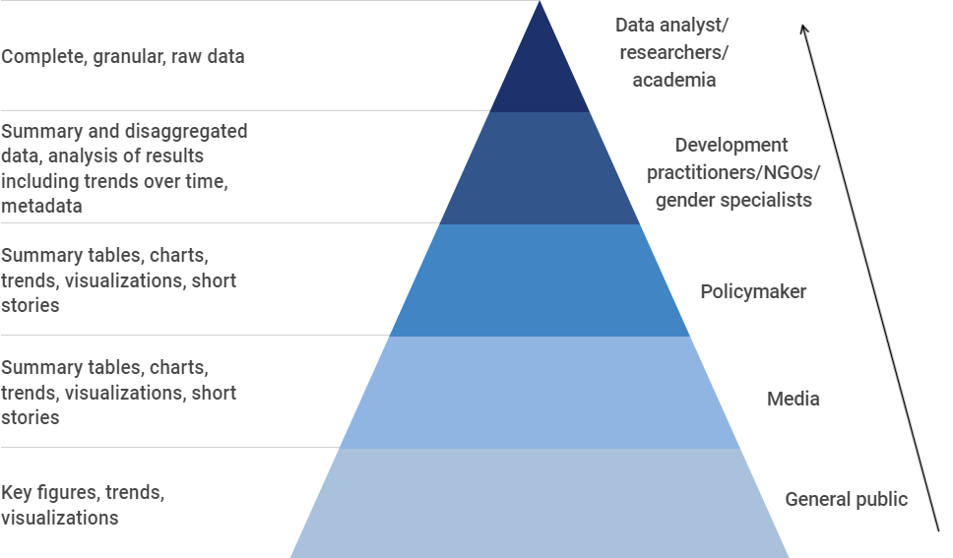
HOW TO TAILOR COMMUNICATION ACCORDING TO USER TYPE
Level of detail increases
As level of expertise increases

Slide 13
ELEMENTS OF A DATA COMMUNICATIONS PLAN
1. DATA PRODUCT OVERVIEW
Summarize the main attributes of the gender data product that will be the focus of communication
2. PURPOSE
Why do you want to communicate the gender data?
3. TARGET AUDIENCES AND PARTNERS
To whom do you want to communicate the gender data and who do you need to partner with to effectively reach them?
MODULE A TO D COMMS TRAINING| OCTOBER 2020
Notes:
Here is how to use the characteristics and apply it into a strategy:
Always use your theory of change of the program to identify and inform your purpose of the communication plan.
Ask the questions: what do we want to achieve and how can we achieve that.
Who will be your target audiences and potential multipliers of your message? Identify them in line with the purpose that you have identified. It is very important to consider audiences not just as the end point of the message, but as individuals and groups who can act as multipliers i.e., will be either very effective at spreading the message or to act upon it.

Slide 14
ELEMENTS OF A DATA COMMUNICATIONS PLAN
4. ACTIVITIES, TIMELINES AND RESPONSIBILITIES
What needs to be done to execute the plan, by when and who will be responsible?
5. CHANNELS & TOOLS
How do you want to communicate the key messages and using which channels?
6. KEY MESSAGES
What are key messages do you intend to communicate?
MODULE A TO D COMMS TRAINING| OCTOBER 2020
Notes:
It is important to consider resources when you decide on activities, timelines and responsibilities – all of these will be determined by how much time and financial resources are available.
CHANNELS: Think carefully about the communication channels and tools that will be most appropriate to the target audience and purpose of the communication.
KEY MESSAGES: In communication a very important consideration is LESS IS MORE. You must simplify and distil your messages to determine what exactly you want to get across. Key messages reduce data waste and increase effectiveness of communication.

Slide 15
CASE STUDY
The Women Count programme of UN Women is driven by a global communication strategy that is customized and implemented by regional and country offices based on their particular contexts and needs. Annex 1 provides the template a communication strategy template used by the programme.
Notes:
Note: users are not monolithic and there are different levels of data literacy among users

Slide 16
MEDIA MONITORING
Important for closing the communications loop
This should involve an analysis of mainstream and alternative media publications, as well as obtaining related social media traffic metrics.
Paid tools and services provide comprehensive media monitoring by tracking mentions.
Manually track citations through Google Alerts and mentions through social media analytics (impressions and engagements are provided on each post on the different platforms).
Decide on your KPIs – how are you measuring successful use and uptake of your communications product?

Slide 17
CONCEPTS
03
ETHICS

Slide 18
KEY CONCEPTS
PRIVACY: Protecting individuals' personal information and adhering to data protection regulations.
INFORMED CONSENT: Obtaining informed consent from individuals when collecting and using their data for journalistic purposes.
DATA ACCURACY: Ensuring the accuracy and integrity of data used in reporting, verifying data sources and avoiding misrepresentation.
Notes:
Thanks to Rose and Altynai for their inputs to this section. Ethics in data collection involve thinking about who the data is about, and also in how we are analysing and visualizing the data.
In thinking about data and being mindful that we are often sharing details about individuals

Slide 19
KEY CONCEPTS
DATA BIAS: Being aware of potential biases in data collection, analysis, and reporting that could skew conclusions and addressing them.
DATA SECURITY: Safeguarding data against unauthorized access, breaches, or misuse.
TRANSPARENCY: Disclosing the methods, assumptions, and limitations of data analysis and interpretation to enable readers to understand the context and potential biases.
Notes:
Thanks to Rose and Altynai for their inputs to this section.

Slide 20
DOs AND DON’Ts – IN OTHER PARTS OF THE MODULE
STEREOTYPES: Avoid using pink for women and blue for men, or putting men first, when listing men and women together, or in icons
GENDERED LANGUAGE: Be sensitive to making gendered assumptions about the data in your descriptions and analyses.
Notes:
Thanks to Rose and Altynai for their inputs to this section.

Slide 21
TECHNIQUES
WHERE TO FIND GENDER DATA
04

Slide 22
4.1 DATABASES AND DATA PORTALS
Databases are organized collection of data managed using a logical structure
Data portals are interfaces that serve as gateways to data otherwise stored in a more complex way
Country databases - INSTAT
Global databases – SDG Global database
Interactive data portals - Women Count Data Hub
Expert users
Pre-processed micro-databases - DHS STATcompiler
Microdata repositories - Multiple Indicator Cluster Surveys (MICS) repository
Notes:
Examples to be provided of country databases and portals, at global and national level.
General/novice users– interactive data portalsProducers: how can you build these tools to make data available to users
Users: how can you use these tools to extract data
Intermediate users – global database
Expert users – pre-processed micro-databases, microdata repositories

Slide 23
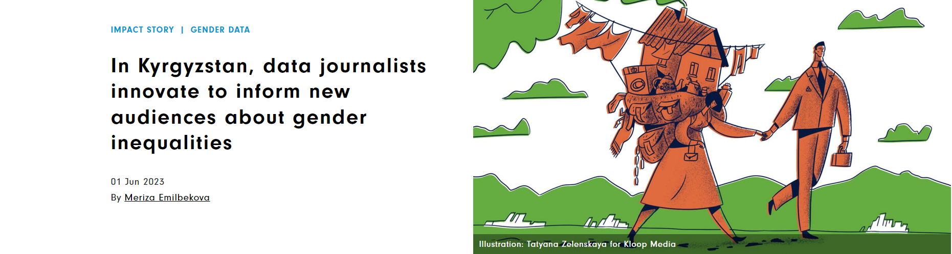
CASE STUDY ON USING DATABASES AND DATA PORTALS
“Understanding and explaining gender inequality requires evidence. Data provide a means to substantiate inequalities, track progress over time, and gauge whether any progress is being made towards achieving gender equality.”
- Altynai Mambetova, co-founder of the School of Data

Slide 24
REPORTS
4.2. STATISTICAL REPORTS
Organized synthesis of data presenting findings from a data collection exercise
Examples:
Gender and Environment Survey Report: Kingdom of Tonga
Bangladesh time-use survey
4.3. RESEARCH REPORTS
Bring together data and analysis from different sources to highlight areas of focus and make policy recommendations
Examples
Country reports: Afghanistan crisis update: Women and girls in displacement
Regional reports: The lingering gendered consequences of COVID-19 in Asia and the Pacific
Global reports: Progress of the World’s Women

Slide 25

CASE STUDY
UN Women’s research report on the COVID-19 rapid gender assessments in the Asia-Pacific region influenced several positive initiatives in the Maldives.
Go to story>>

Slide 26
CHECKLIST
Identify the target audience before crafting a report and tailor the content and format to the target audience.
Focus on topics that are a priority for the target audience.
Use gender statistics for non-statistical reports as well, but avoid technical jargon for non-technical audiences.
Always include insights and context into the gender data used and discuss the caveats of the data.
Always keep a balance between graphs and text, to enable readers to get the full picture in an engaging way.
Women and men should be presented side-by-side in graphs
Order your data from lowest to highest value before showcasing it through graphs and charts.
See more in Section 5: Data Visualizaton

Slide 27
TECHNIQUES
HOW TO
VISUALIZE DATA
05

Slide 28

KEY CONCEPTS
5.1. The importance of data visualization
Graphical presentation of data
Helps summarize and make sense of data
Improves how data is viewed and understood
WHAT
WHY
See trends and outliers
Uses visual elements like charts, tables and infographics
Engage readers visually
WHO
Notes:
What is data visualization? Why visualize data? Who are the users of data visualizations

Slide 29
WHO: THE USERS
Different kinds of users along the spectrum
Producers
Technical
Data sets
General
Messaging
Pictorial

Slide 30
KEY CONCEPTS
5.2. Principles of data visualization
CLARITY
NARRATIVE
DESIGN
1.
2.
3.
Convey the message clearly
Data is storytelling
Balance visual and function
Notes:
CLARITY
The data visual must be simple to understand and convey the message clearly
Focus on maximizing the impact and minimizing the noise
If an element does not add any value to the visual, get rid of it
NARRATIVE
Data is storytelling (see section 5)
Weave a story around the data so they look relevant and relatable to the audience
DESIGN
Striking a balance between the visual design and practical utility of the visual element is key

Slide 31
RECOMMENDATIONS FOR PRESENTING GENDER DATA IN VISUALIZATIONS
Women and men should be presented side-by-side to facilitate comparison.
Women should always be presented before men.
Use words ‘women’ and ‘men’ instead of ‘female’ and ‘male’, as the latter may have social connotations.
Data should be rounded to 1,000, 100 or 10 and percentages should be rounded to integers, to facilitate comparison between women and men.
Gender-blind totals should be deleted in tables and graphs.
Source: UNDESA. 2017.

Slide 32
5.3. TYPES OF CHARTS
Elements of a chart
Title: e.g., Proportion of women ages 20–24 in a union before age 18, percentage, 2014
Axes: X Axis (the horizontal line) and Y Axis (the vertical line)
Axis label: Text that appears by the axis and indicates what is being measured and the unit (e.g. year, percentage).
Data labels: Visualize the data points in the chart by showing the data labels.
Legends: Distinguish the different elements in the chart, such as the patterns or colours.
Data source: Identifies the origin of the information depicted in the chart.

Slide 33
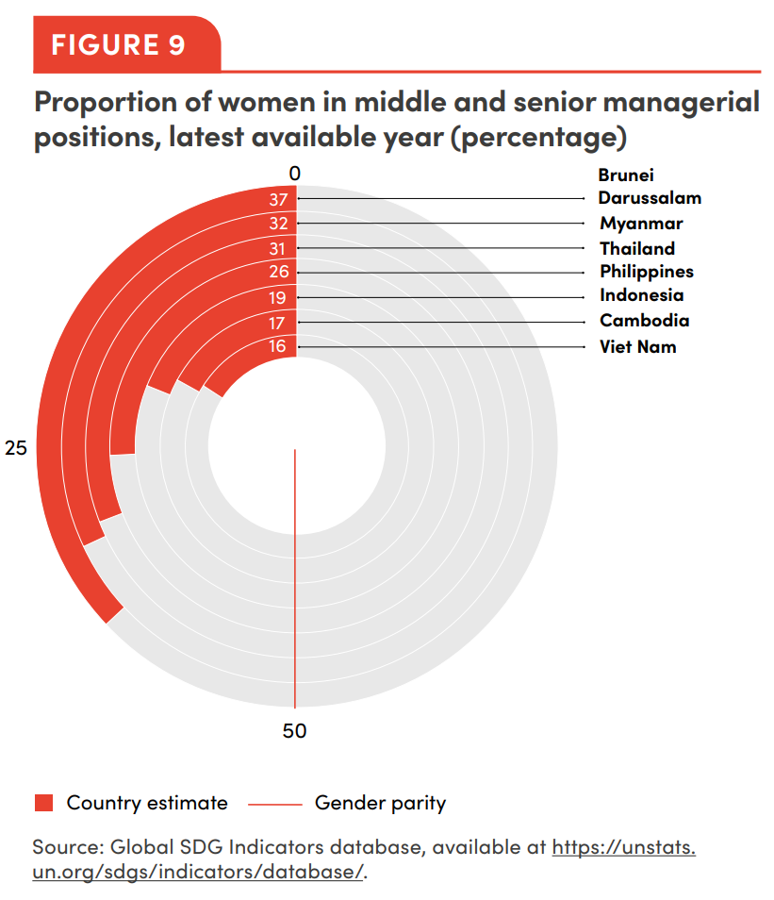
CHARTS
Bar chart
Line chart
Pie chart
Scatter plot
Maps
ADVANCED CHARTS
Box plots
Radar charts
Sankey charts
Combination charts

Slide 34
KEY CONCEPTS
Which chart to use?
For comparison, i.e., seeing how two items are similar or different, use a bar chart. To compare change over time, use a line chart.
For composition, i.e., what parts make up a whole, use a pie chart. To look at composition change over time, use an area chart.
For location, use a map.
Non-data elements
Infographics, pictograms/icons, typography

Slide 35
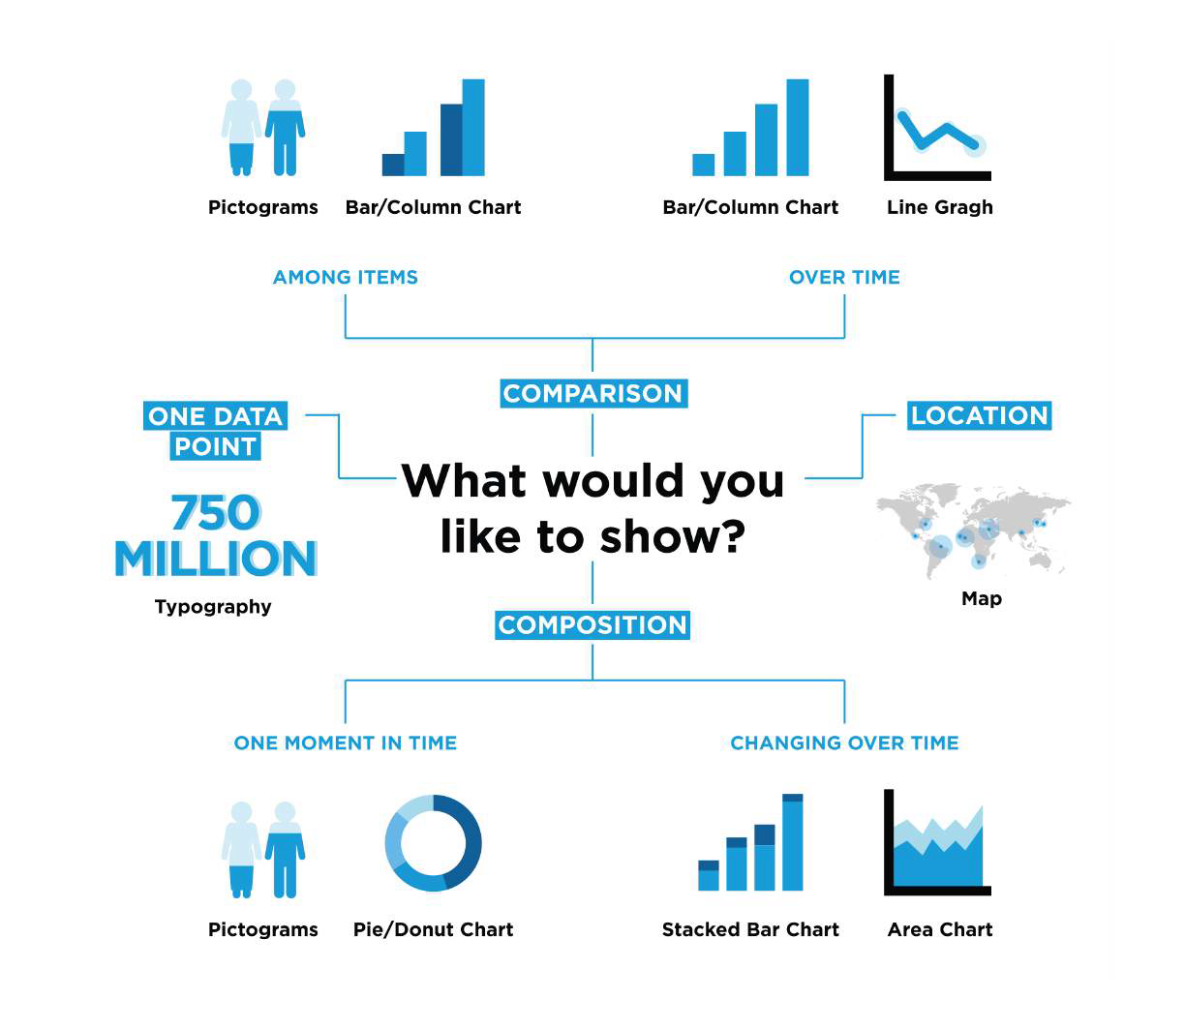

Slide 36
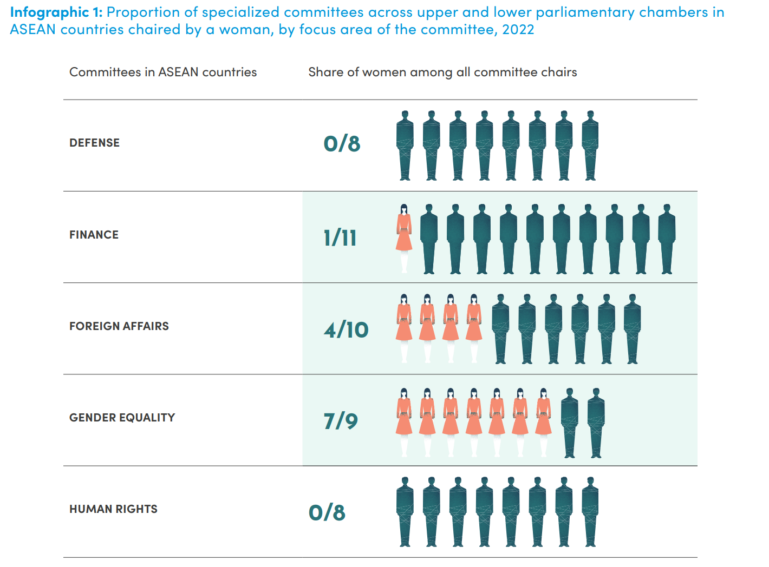
TOOLS AND TECHNIQUES
Other visualizations
5.4 Infographics
  Data, Visuals, Narrative
  Elements of an effective infographic
5.5. Fact sheets
  Anatomy of a fact sheet
5.6. Multimedia
combines two or more types of media, such as photo, audio, video or web

Slide 37
TIPS FOR PLANNING MULTIMEDIA CONTENT
What is the purpose and the story you want to tell? Is it to educate, advocate, inspire action?
Who is the target audience?
How, where and when will you reach your target audience?
Is this the best format to communicate gender data to my target audience
What is your budget and timeline? Here are some considerations that can impact both:
How will you measure success? Is it about total views, downloads, audience retention, new followers?

Slide 38

CASE STUDY
After undertaking its first-ever Gender and Environment Survey (GES) in 2022 – one of only a handful conducted globally – the Tonga Statistics Department (TSD) and UN Women co-produced a short video capturing the voices from women and men impacted by disasters and surveyed in various Tongan islands.

Slide 39
ACTION
06
DATA STORYTELLING

Slide 40
KEY CONCEPTS: DATA IN CONTEXT
Context is one of the key principles of data feminism covered in Box 2: data are never neutral or objective.
The characteristics and values of people involved along the value chain influence the process every step of the way, including what gets measured and what remains invisible.
If we are to use data effectively, we need to examine and understand the context in which they were conceptualized, designed, collected, analysed, reported on and used.
On counting those who have previously been uncounted, see this story on how LGBTIQ+ people were counted for the first time in Nepal’s Census.
To understand the story behind each data point, see this story on how women with disabilities have been affected by the pandemic.
Also look at the UN Women and PARIS21 training for data users such as journalists, activists and data enthusiasts on how to craft compelling narratives and products using gender data

Slide 41
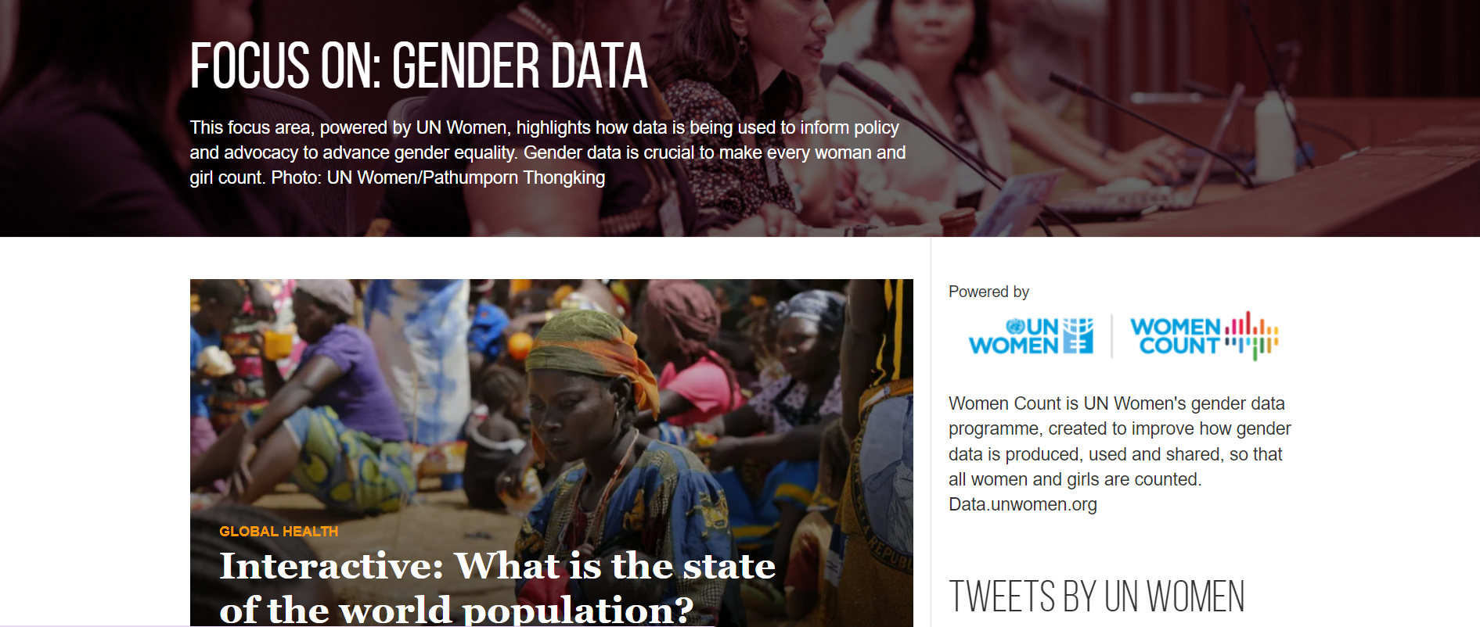
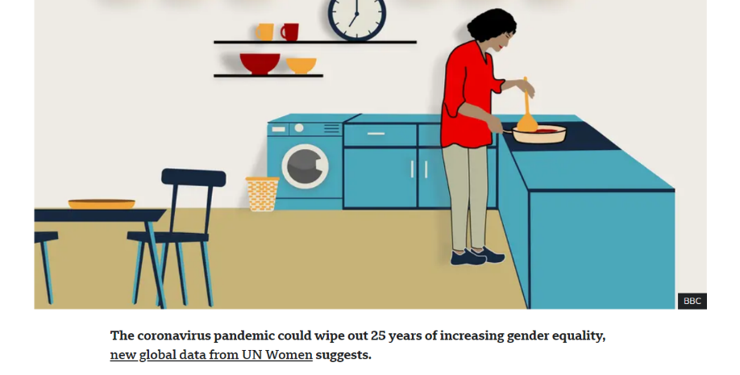
6.1. RELATIONSHIPS WITH THE MEDIA
CASE STUDY: DEVEX FOCUS ON GENDER DATA
CASE STUDY: BBC 100 WOMEN FOCUS ON UNPAID CARE

Slide 42
RECOMMENDATIONS: BUILDING DIALOGUE WITH JOURNALISTS (PRODUCERS)
Build and leverage long-lasting relationships with media organizations and individual journalists
Build the capacity of journalists on both statistics and gender through training and partnerhips
During press conferences and media briefings, be prepared with key messages and talking points
Avoid technical jargon but use simple language to state facts, leaving no room to misinterpret data.
Design materials that support your message and are useful to the media, like fact sheet
Provide open access to the data through Excel files.
Create a culture of transparency – if you don’t have an answer to a question, be honest but get their contact details to follow up with them.

Slide 43
RECOMMENDATIONS FOR JOURNALISTS ON WORKING WITH DATA PRODUCERS
Be mindful of the differences between official and non-official statistics and choose official statistics whenever available
Once you have selected the data you want to use, ensure that you fully understand it – when in doubt, read the associated metadata
If you find caveats on your data, mention them in your media product, either through footnotes or through simple explanations so the readers understand the reliability and significance of the figures.
Make sure you are interpreting the data correctly and using the right language.
If you can’t find the data you are looking for, don’t assume the data do not exist. Reach out to the National Statistics Office for guidance
If the data are not available in the exact format you are looking for, you can also contact national statisticians to request different formats, or you can transform it yourself
If you find that, even after contacting national statisticians, the data you are looking for are unavailable, use your media product to highlight important gender data gaps and raise public awareness on data availability

Slide 44
6.2. WRITING A GENDER DATA STORY
Tips for writing effective gender data stories
Use a strong headline/title to capture the reader’s attention and convey the key message.
Summarize the key points in the lead sentence or introductory paragraph. Human interest stories may open with a quote or a story from a woman affected by the change, which lends further context to the situation.
In the main body, provide the context for the gender data being presented, add further detail, and include colour in the form of quotes from people involved.
Where relevant (particularly in evidence-based stories), illustrate the data through charts and infographics and make sure they are properly sourced and labelled.
End with a call to action, either with some recommendations for change, or a link to read more. Stories can end with a colourful ‘kicker’ quote or details about what is next.

Slide 45
CASE STUDIES
Story of change: Uganda’s violence against women survey heralds legislative and policy changes
Evidence-based advocacy: Leaving no girl behind in education

Slide 46
6.3. WRITING A PRESS RELEASE
1. Heading – For documents to be issued, use your organization’s letterhead. For web releases, a letterhead is not needed. Include the date of the press release and the text “For Immediate Release” or “Under embargo until DATE”
2. Headline – A short and “catchy” headline should grab the reader’s attention and very briefly summarize the main takeaway. Use the present tense to convey immediacy.
3. Body – The first paragraph should summarize the key message of the press release. The first sentence should state what is happening. Also start the sentence with the location from which the press release is being issued.
4. The five Ws: Who? What? Where? When? Why? – Who is doing what, and who is most affected? What is happening? When and where is this happening? Why is this happening, or why is this newsworthy? Include ‘colour’ in the form of quotes, along with key data and findings.
5. Call to Action – Include a link to the report or other resource you want to highlight. Include the names of the media contacts, so journalists know who to call to request an interview or for more information.

Slide 47
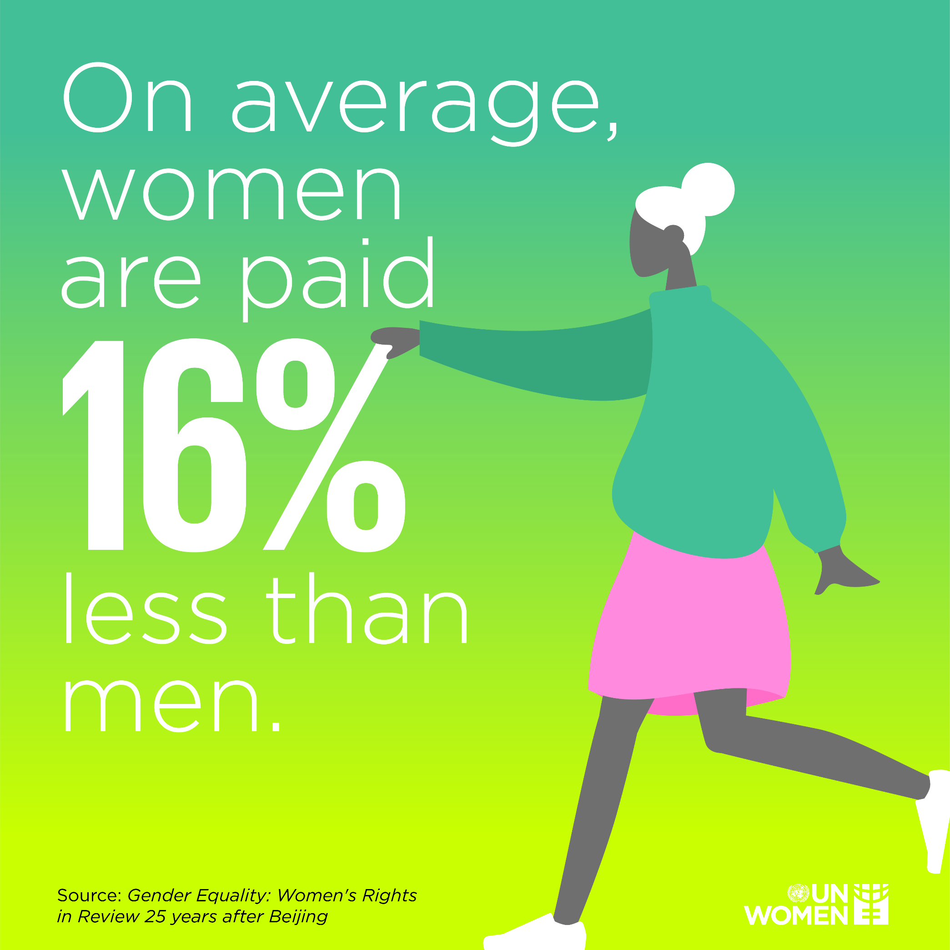
KEY CONCEPTS
Social media helps share a message out but also invite audience in (interact)
CONCISE: Simple, easy to understand
ATTENTION GRABBING: Hook the user
AUTHENTIC: link to human or real-life stories
JARGON FREE: Avoid technical terms
NON-SENSATIONALIST: inform without being misleading
Notes:
CONCISE
Simple, easy to understand and must not pack too many different datapoints at once.
ATTENTION GRABBING
Hook the user in with a compelling, meaningful and punchy message. Pair that with powerful imagery or visuals.
AUTHENTIC
Where you can, link to human stories or current affairs, and always be true to your own voice and brand message.
JARGON FREE
Avoid using technical specialized terms not understood by everyone
NON-SENSATIONALIST NOR MISLEADING
Ethically inform and persuade, without blowing something out of proportion

Slide 48
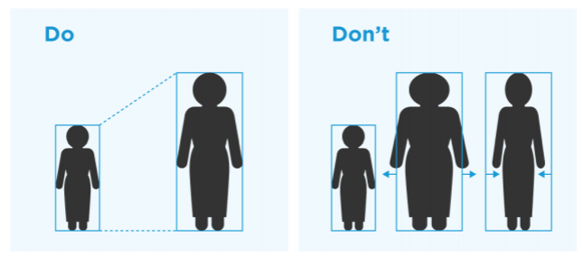
GOOD PRACTICES FOR SOCIAL MEDIA
Keep in mind format sizes:
  Instagram: 1080x1080 px
  Facebook: 1200x630 px
  Twitter: 1024x512 px
Write an image description or ‘alt text’ which describes what is in the picture. You can add this to the ‘backend’ of your image
Should be shareable with every device: phone, laptop, desktop, tablets
Include a call to action – link to a report or site
Videos need closed captioning
Size icons proportionately
Text should be legible across screen sizes
Graphic element should not pack in too many details

Slide 49

GOOD PRACTICES FOR SOCIAL MEDIA
Simple icons that everyone understands
Data-driven text and image showing 1 in 3 women
Concise and simple message
Source of data
UN Women, Twitter 2020

Slide 50
ACTION
07
EDUCATION

Slide 51
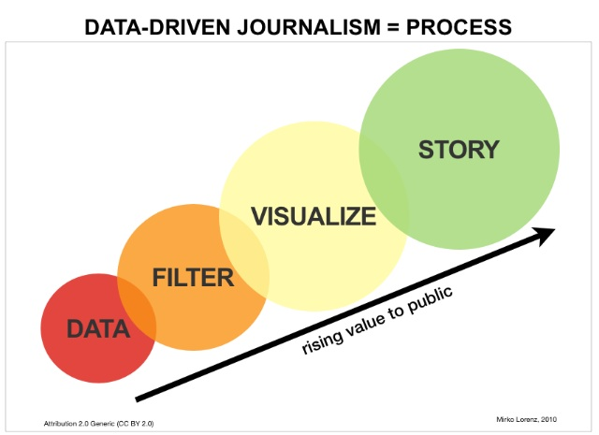
GUIDELINES FOR EDUCATORS
Teach ethical guidelines: Accuracy, fairness, objectivity, and transparency.
Analyze case studies: To deepen understanding of ethical challenges in journalism.
Foster critical thinking: Fact-checking, verifying sources, and analyzing biases.
Promote media literacy: Identify and evaluate reliable sources, recognize bias.
Notes:
Teach ethical guidelines: Students should be familiar with established codes of ethics, including accuracy, fairness, objectivity, and transparency.
Analyze case studies: Engage students in analyzing and discussing case studies involving ethical dilemmas journalists face to develop a deeper understanding of ethical challenges in journalism.
Foster critical thinking: Emphasize the importance of critical thinking skills in assessing the validity and credibility of sources, including fact-checking information, verifying sources, and analyzing biases.
Promote media literacy: Educate students about media literacy and the impact of misinformation and fake news. Teach them to identify and evaluate reliable sources, distinguish between fact and opinion, and recognize potential bias.

Slide 52
THE END…
FOR NOW

