Slide 1
ASIA-PACIFIC TRAINING CURRICULUM ON GENDER STATISTICS
WHAT IS GENDER DATA AND HOW TO USE IT FOR SDG MONITORING?

Slide 2
Become familiar with the concepts of sex and gender
Understand the multidisciplinary nature of gender statistics.
Gain knowledge on how gender statistics can help monitor the SDGs from a gender angle, in the spirit of inclusiveness.
Understand the reasons behind the lack of some gender-related SDG data, and potential solutions to overcome related challenges.
1
Learning objectives

Slide 3
WHAT IS GENDER DATA
Sex vs. Gender
Generally, data is disaggregated by sex
Sex-disaggregated statistics are part of gender statistics, but gender statistics are much broader
Sex vs. Gender
Sex | Sex refers to the biological differences between women and men
Gender | Gender refers to the role of a woman or man in society, it is constructed over time

Slide 4
SEX OR GENDER?
1) After delivery the doctor will reveal to the mother the ____ of the child 2) In order to understand the differences in enrolment rates between girls and boys, the data must be disaggregated by ____ 3) A person’s _____ might or might not align with his or her _______ identity 4) Data is typically disaggregated by binary definitions of _____, but some countries are starting to develop methodologies to capture ______ dimensions and apply these for disaggregation 5) Women and men’s ______ roles in society determine how much time they spend doing domestic work 6) ______ statistics include _____ disaggregated statistics and other ______ specific indicators that capture the realities and the differences in the lives of women and men
Sex
Sex
Sex
Gender
Sex
Gender
Gender
Gender
Sex
Gender

Slide 5
GENDER STATISTICS
Gender Statistics capture the specific realities in the lives of women and men - Gender statistics go well beyond sex-disaggregation - Gender statistics comprise: - Sex-disaggregated data - Data pertaining specifically to women or to men - Data that captures specific gender issues (even when non explicit)
Gender data cuts across all areas of sustainable development

Slide 6
ARE THESE GENDER STATISTICS?
Proportion of population living in slums, by sex
Maternal mortality ratios, per 100,000 live births
Incidence of prostate cancer
Tobacco use rates in China
Proportion of households using clean fuels for cooking and heating
Total value of inward and outward illicit financial flows, in USD

Slide 7
GENDER DATA VS GENDER STATISTICS
Gender data are data points for men, women or for issues that affect women or men particularly.
Gender statistics are the estimates calculated utilizing gender data.
In practice, and throughout these course, both words are often used interchangeably.
Image source: Studybay group

Slide 8
GENDER AND THE SUSTAINABLE DEVELOPMENT GOALS (SDG)
The 2030 Agenda for Sustainable Development: - Adopted by all UN Member States in 2015 - Provides a shared blueprint for peace & prosperity for people and the planet. - At its heart are the 17 Sustainable Development Goals (SDGs) - Each of the 17 Goals include a series of targets - To measure progress towards the targets we use more than 200 indicators - The SDGs are a follow-up to the MDGs, but apply for developed and developing countries

Slide 9
GENDER ACROSS THE SDG INDICATOR FRAMEWORK
- Gender indicators are present across many SDG goals.
- Well beyond goal 5.
- Without gender equality the SDGs cannot be achieved
- Without gender statistics, inclusive progress towards the SDGs cannot be measured
Image source: Turning promises into action. UN Women 2018

Slide 10
GENDER ACROSS THE SDG INDICATOR FRAMEWORK

Slide 11
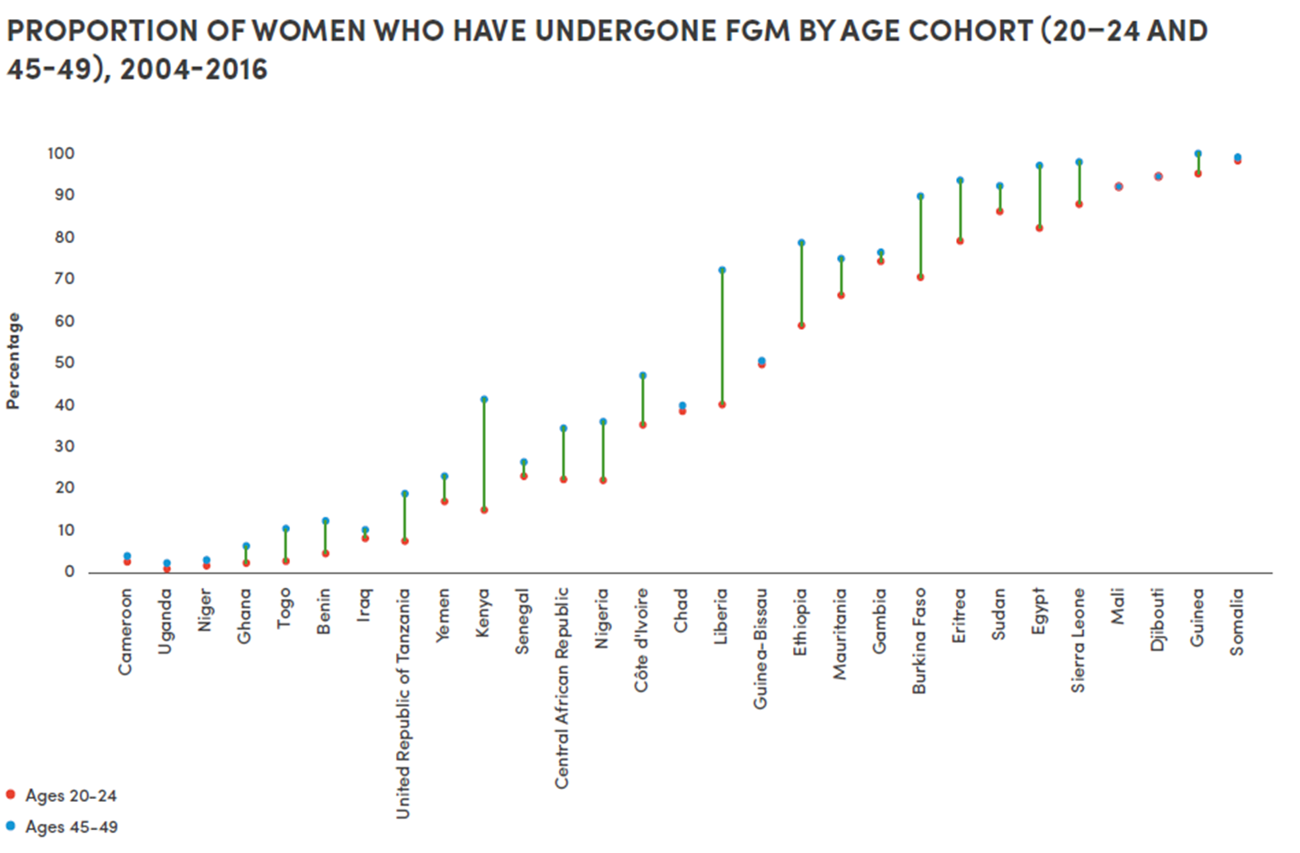
TYPES OF GENDER INDICATORS FOUND ACROSS THE SDG MONITORING FRAMEWORK
1) Targeted gender-specific indicators
Image source: Turning promises into action. UN Women 2018

Slide 12
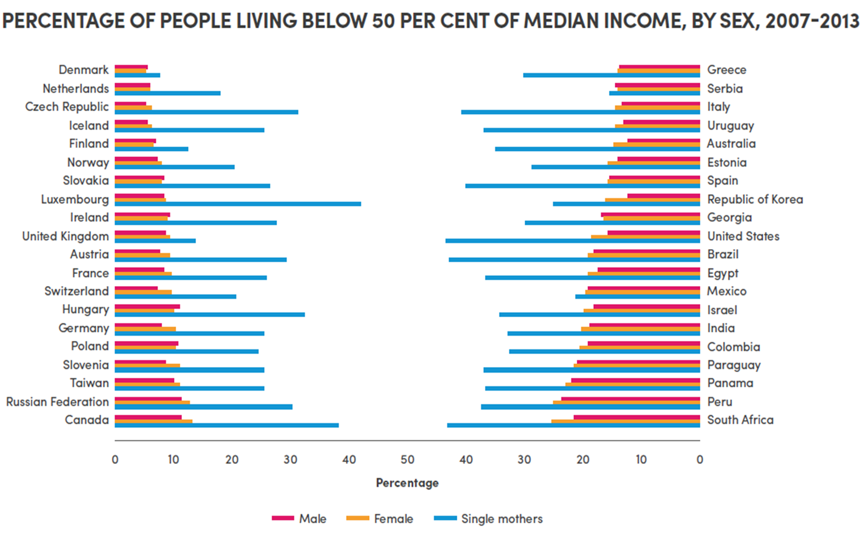
TYPES OF GENDER INDICATORS FOUND ACROSS THE SDG MONITORING FRAMEWORK
2) Sex disaggregation is explicitly mentioned
Image source: Turning promises into action. UN Women 2018

Slide 13
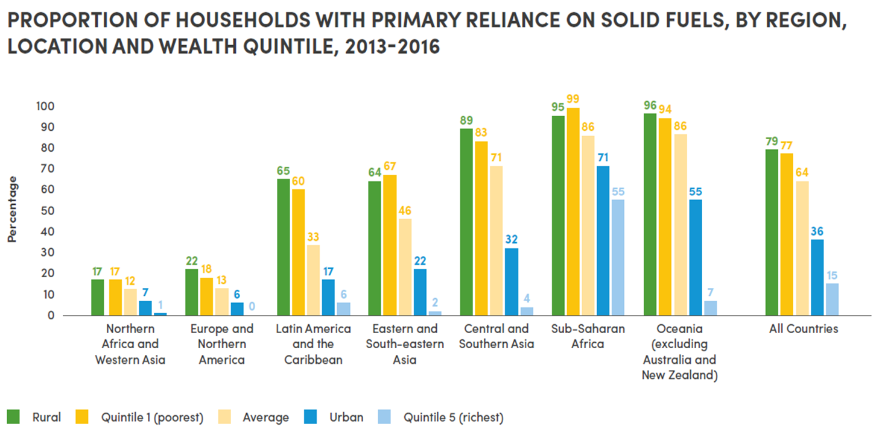
TYPES OF GENDER INDICATORS FOUND ACROSS THE SDG MONITORING FRAMEWORK
3) Additional indicators that capture a gender angle (gender-relevant)
Image source: Turning promises into action. UN Women 2018

Slide 14
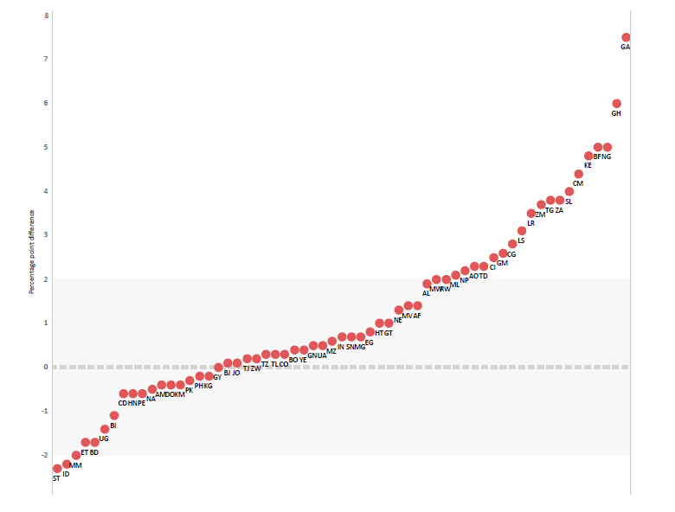
TYPES OF GENDER INDICATORS FOUND ACROSS THE SDG MONITORING FRAMEWORK
Other indicators across the framework might not be gender specific but are still gender-relevant, as additional disaggregation could potentially be performed
Image source: Azcona, Duerto, Bhat, 2020. Harsh Realities: Marginalized women in cities of the developing world.

Slide 15
WHY ARE GENDER STATISTICS IMPORTANT?
Without gender data we are getting an inaccurate picture.

Slide 16
WHY ARE GENDER STATISTICS IMPORTANT?
Policy making
Accountability
Advocacy
ACHIEVE THE SDGs FOR ALL
Analysis/Academic research

Slide 17
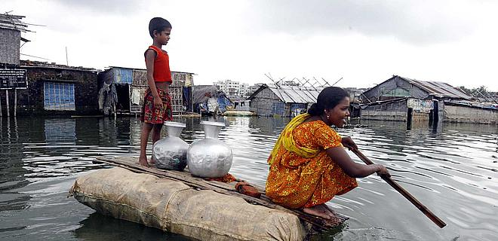
WHY ARE GENDER STATISTICS IMPORTANT
Image source: The better India

Slide 18
KEY AREAS WITH GENDER GAPS IN ASIA AND THE PACIFIC
Largest data gaps
New and emerging areas of statistics
Hard to reach population groups
Pacific Island Countries and territories

Slide 19
ENHANCING AVAILABILITY AND USE OF GENDER DATA
CHALLENGES TO GENDER DATA PRODUCTION/USE
SOLUTIONS (INCLUDING WOMEN COUNT)
Weak policy space
Lack of political will
Inadequate resources
Technical challenges
Limited coordination among NSS actors
Limited technical capacity in methodologically challenging areas
Lack of access to data
Limited awareness
Insufficient dissemination/communication
User-producer disconnect
Enabling environment
Strategies/Laws prioritize gender data
Gender data production
Build capacity in technically challenging areas such as Time Use, Environment, Violence surveys
Reprocess existing data
Data dissemination & use
Communicating data efficiently
Better exchanges (SDMX)
Gender-sensitive SDG localization
Intergovernmental work for methodological developments and S-S cooperation
User-producer dialogues
Source: Making Every Woman and Girl Count Inception document

